Slide 1
Traversable wormholes in 4 dimensions
Juan M. Maldacena, Alexei Milekhin, Fedor K. Popov
Princeton University
arXiv:1807.04726

Slide 2
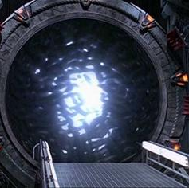
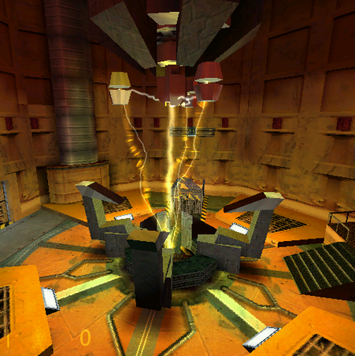
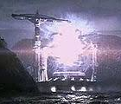
Examples of interstellar travels
A portal in the movie “Contact”
Portals and "resonance cascade“ from the universe of Half-Life
An intergalactic subway from Stargate
Black Hole that leads really to hell

Slide 3
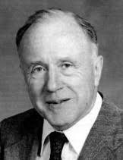
The main leitmotif of these ideas is the existence of Wormholes

Slide 4
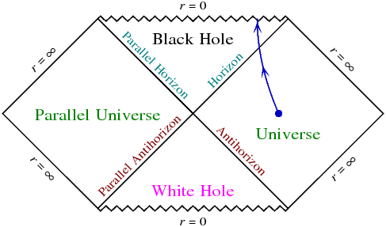
The first example of the wormhole
The first example of the wormhole is a usual black hole
Just expand the area between
the Horizon and the Antihorizon.
You would get two black holes.
So we can start with two BH.

Slide 5
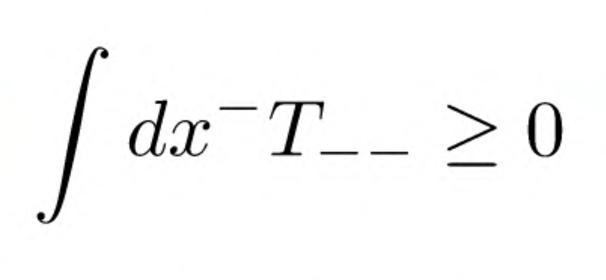
The sci-fi wormholes in general relativity
Forbidden by the Achronal (=fastest line) Average Null Energy Condition + Einstein equation

Slide 6
What about longer wormholes?
Still can be used for a good novel
Still is not possible due to the Null Energy Condition
But this is easier to violate by some exotic matter
For example, can be violated by galelions (also they can help to get bouncing solution instead of big bang one)
Also Casimir energy satisfies this condition and it is not so unusual

Slide 7
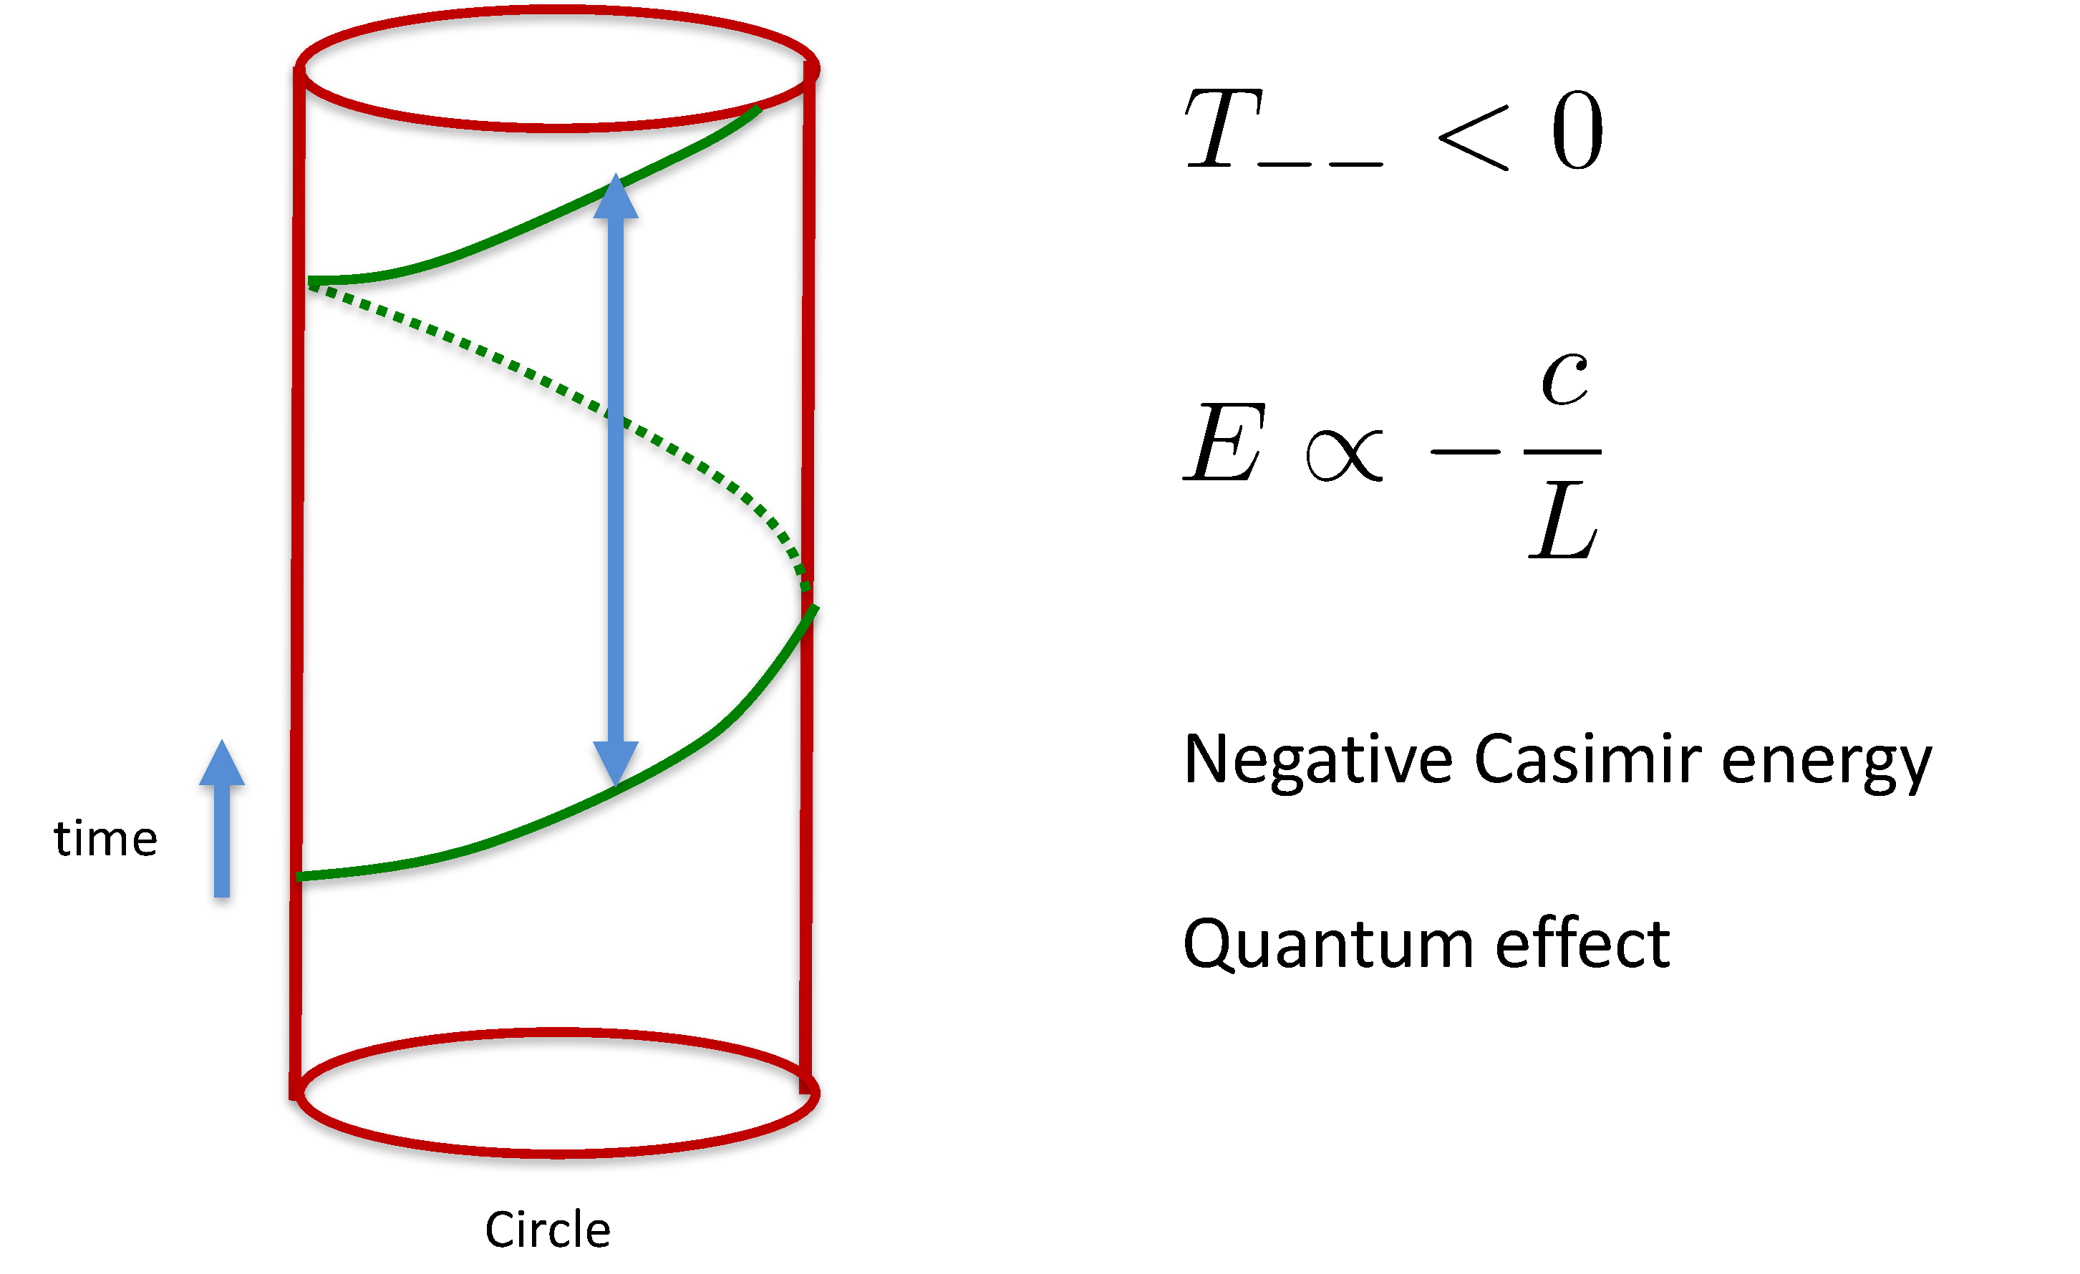
The Null Energy condition and Casimir Energy

Slide 8
The theory and recipe for wormholes
Einstein-Hilbert action provides dynamics for metric
Fermions creates negative null-energy for sustaining wormhole solution
Electromagnetic field is responsible for circulating of fermions

Slide 9
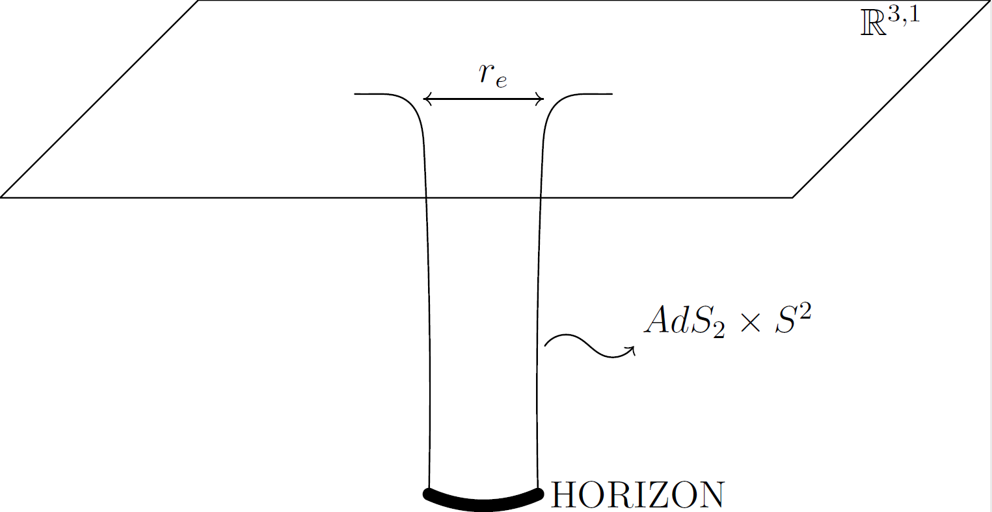
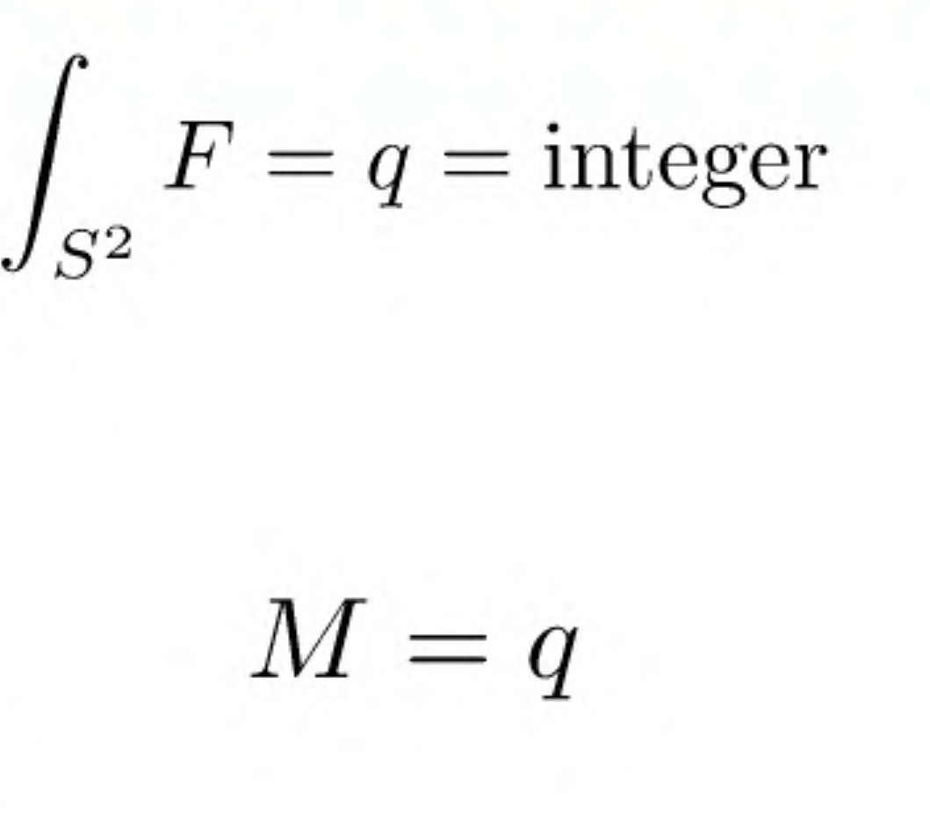
We start with consideration of one near-extremal magnetically charged black hole

Slide 10
JT Gravity
Near horizon area of near-extremal black hole can be effectively described by two-dimensional JT gravity
One can get immediately null-energy condition out of this description

Slide 11
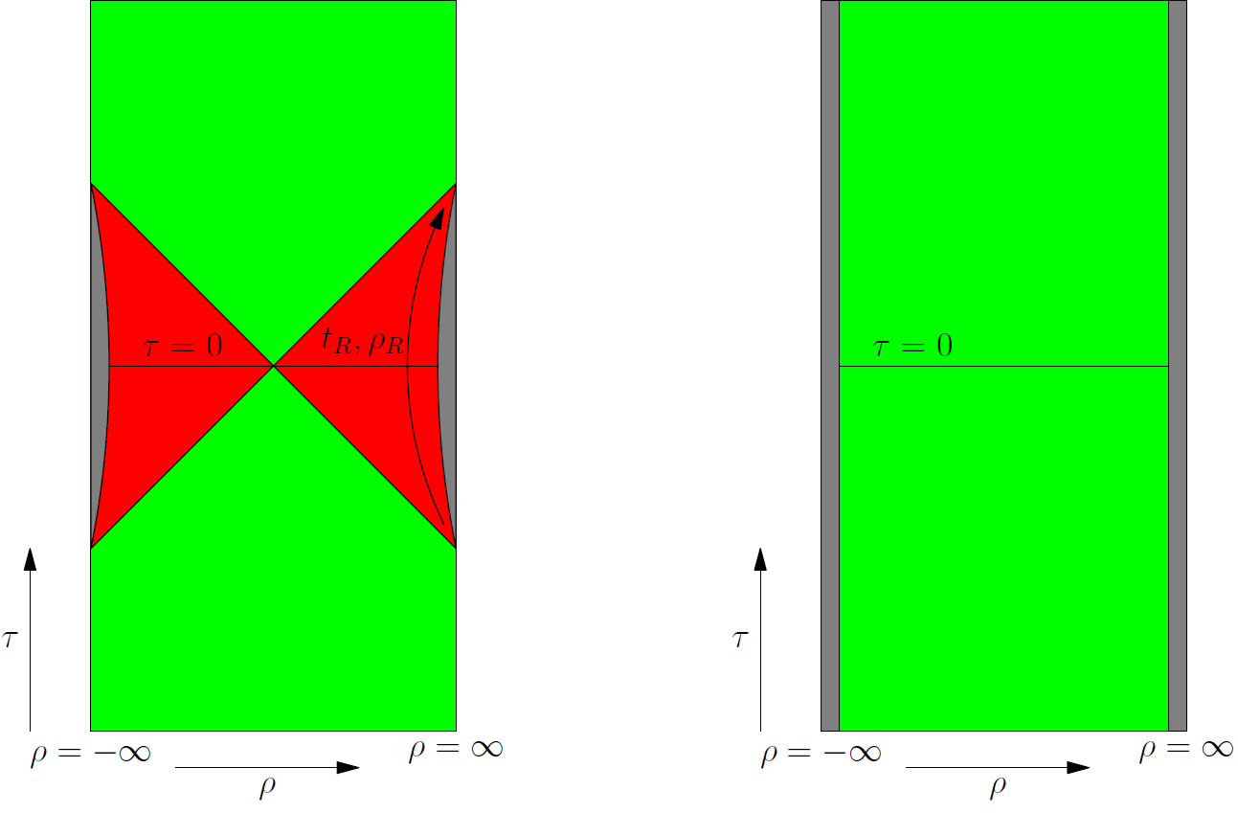
In JT gravity we get AdS2 and dynamical boundary
JT gravity is not a complete description of the system. We must introduce cut-off.
It gives an effective way to compare
black hole and wormhole phases.
Introduce the interaction between
boundaries (effective attraction) and
We get a wormhole!

Slide 12
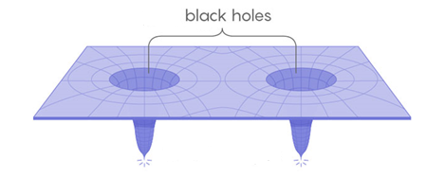
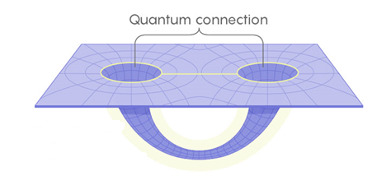
Interaction induces black holes to create a wormhole
interaction
But if one turns it off the wormhole will collapse
AdS2 x S^2

Slide 13
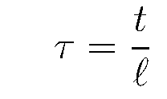
The temperature of the wormhole
The metric inside the throat
We introduce temperature as the factor that rescales AdS_2 time and the asymptotic time
If we turn off the interaction we effectively get a state with this temperature

Slide 14
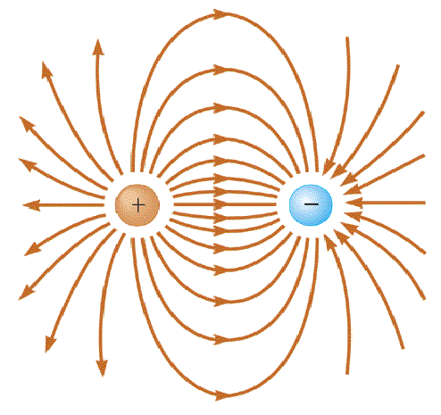
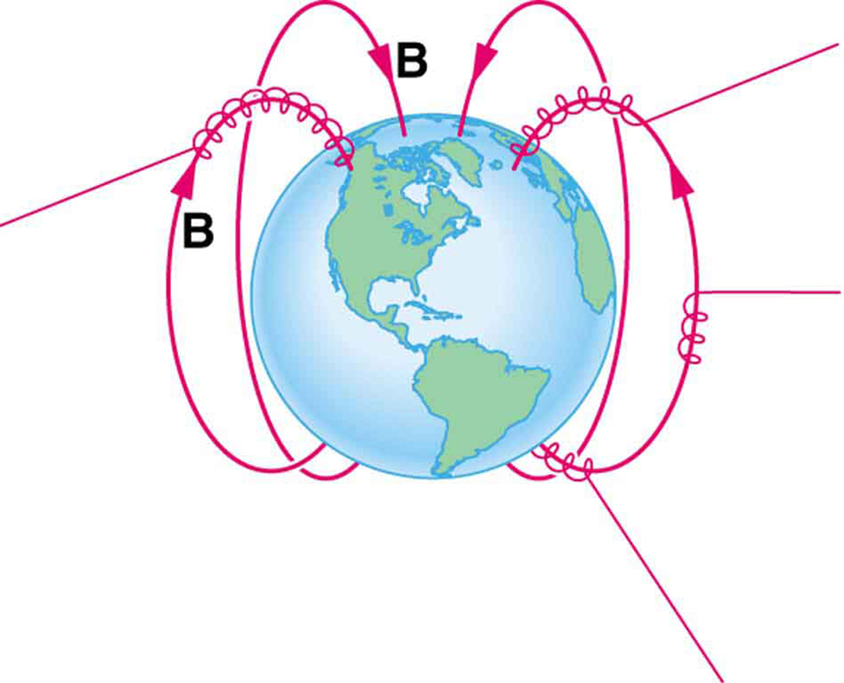
Fermionic massless modes
Due to the presence of magnetic charges, fermions have q massless modes. The mechanism is similar to a Landau level
Can be explained by anomaly: 4d anomaly (E x B) -> 2d anomaly q E -> there should be massless fermions in 2d
We can think of them as moving along magnetic fields

Slide 15
Fermionic massless modes
The spinor can be decamped in the product of two 2d spinors
The angular part can be found exactly and show the existence of q charged massless fermions forming spin j representation
This solutions shows that fermionic modes are localized on the sphere, especially in the large charge limit

Slide 16
Now we can consider magnetic lines as fermion trajectories
Oppositely charged black holes
Charged fermions move
in the throat

Slide 17
Quick variational ansatz for the length of the wormhole
Casimir energy
+ conformal anomaly inside
the throat
We neglected by the difference
between different fermionic trajectories
Classical energy

Slide 18
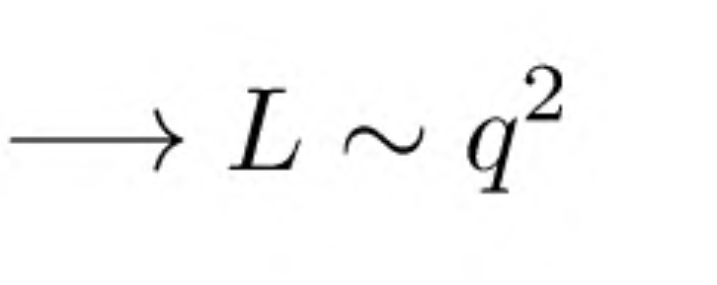
If the last equation did not persuade you one can directly solve the Einstein equations

Slide 19
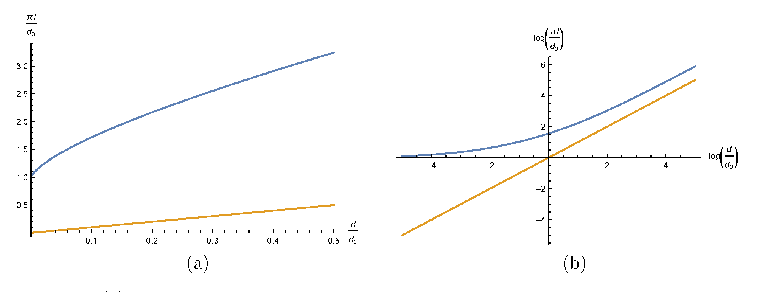
The last solution was right only for q^2>>d
To get the right answer the difference between the trajectories must be taken into account and the finite distance between the black holes
L ~ 2.35 d, d>> q^2

Slide 20
Unfortunately this black holes attract each other and sooner or later they will collapse on each other that would destroy the created wormhole

Slide 21
The way of stabilizing of the double BH system
Create some artificial force that would prevent black holes from falling on each other(for example, uniform magnetic field)
Make them rotate! - the most natural choice

Slide 22
Adding rotation

Slide 23
Some new problems arise from this rotation
Throat is very fragile as it was calculated before. The binding energy is so small that small thermal fluctuation can destroy
Because of the rotation an effective Unruh temperature appears (Sokolov-Ternov effect). It should be less the binding energy.
The first pole is responsible for the temperature. The inverse temperature can be found to be

Slide 25
Thermodynamic stability

Slide 26
Conclusion
We showed a wormhole solution of an Einstein-Maxwell theory with charged fermions
It is a traversable wormhole in 4d without exotic matter
It balances classical and quantum effects
It does not violate causality
It has no horizon and no entropy
Can be described as a pair of entangled black holes

Slide 27
Open questions
We present the initial state of the system and the final state of the system, but we didn’t describe the transition?
How does topology change?
How does the other black hole find another?
What happen if we consider a system of multiple black holes? Can we build a subway system like in Moscow or in London?
Do quantum fluctuations destroy the wormhole?
How did system lose the entropy?

Slide 28
Thank you for your attention

