Slide 1
Chern-Simons Terms and Heterotic Superpotentials
Juntao Wang
Virginia Tech
(Joint work with Lara Anderson, James Gray and Andre Lukas)

Slide 2
Chern-Simons Terms in Heterotic Theory
In heterotic theory, we have the 3-form flux
where
Similar expression for
If we compactify heterotic theory on a Calabi-Yau manifold, we could get
Gukov-Vafa-Witten Potential
If is non-zero, it could make the flux non-zero and then in 4D theory we will have a superpotential, which could be useful, for example in moduli stabilization. In this talk we will discuss the calculation of this term for a general YM vector bundle
For recent work on flat YM bundle case see
Apruzzi, Gautason, Parameswaran and Zagerman arXiv:1410.2603 Gukov, Kachru, Liu, McAllister hep-th/0310159

Slide 3
Conditions Chern-Simons terms need to obey
Bianchi Identity
Which means that Yang-Mills vector bundle and tangent bundle have the same second Chern character
Then by a mathematical result: Two E8 bundles are isomorphic if their second Chern characters are the same
For a proof, see
Witten Int. Jour. Mod. Phys. A Vol. 1 No. 1 (1986) 39-64
Yang-Mills and tangent bundle are the same real objects

Slide 4
Mathematical Definition of Chern-Simons functional
Thomas, J. Diff. Geom., 53 (1999) 367-438
Take two connections , on the same bundle and define:
Then the Chern-Simons functional is defined as:
From this definition, the Chern-Simons terms in string theory is just the mathematical definition of Chern-Simons functional.

Slide 5
An example of real isomorphism on
Does not have no-where vanishing holomophic section
Has no-where vanishing holomophic section
They are different as holomorphic vector bundle
BUT, they are the same as real vector bundle

Slide 6
There are two patches on , we call the affine coordinates on these patches and
Let us define the transition functions of these two vector bundles as:
For a bundle morphism between the two bundles, suppose it is represented as and on the two patches of , they should satisfy:
In order to show the two vector bundles are real isomorphic to each other, we need the morphism to be invertible and non-holomorphic.
And we found the morphisms are

Slide 7
An example of real isomorphism on tetra-quadric
The real morphism is

Slide 8
Calculation of Chern-Simons invariants
Morphism P
Chern connection of
Chern connection of
We also calculate more complicated examples, like a vector bundle which is real isomorphic to tangent bundle of tetra-quadric, and still got zero
So why?

Slide 9
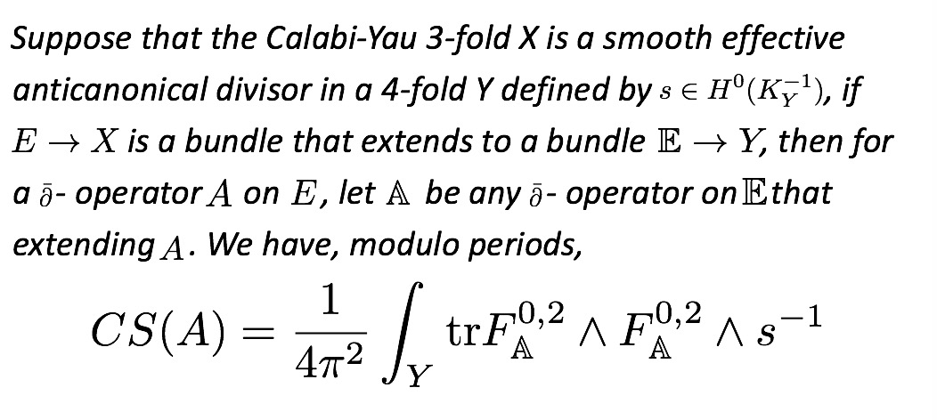
Theorem(Thomas, 1999)
For the case we just looked at, because of the favorable nature of the manifold, the relevant bundles extend holomorphically to the ambient space, as do the Chern connections we have used, and so we get zero.

Slide 10
Thomas’ theorem can be used in the case of complete intersections (for example by applying all but one defining relation and calling the result Y). Before quotienting and adding Wilson lines we believe that all the known Line Bundle Standard Models will have zero Chern- Simons term.
Thomas’ theorem can often be applied to quotients despite the fact that in such cases the ambient space is typically singular. For example this can be the case if the ambient space can be resolved without affecting the Calabi-Yau manifold.
Note the power of this theorem: If the Calabi-Yau manifold admits any description where the conditions of the theorem hold and the connection can be extended holomorphically then the Chern-Simons term is zero.
We still expect there to be cases where the Chern- Simons term does not vanish, which we should be able to compute with this formalism. Building examples of these is what we are working on now.

Slide 11
Conclusions
We have looked at Chern-Simons terms in heterotic superpotentials.
The physics and mathematics definitions agree, at least in simple cases.
We have a method for computing the Chern-Simons terms in some interesting cases based upon real bundle isomorphisms.
A general theorem of Thomas could prove to be quite powerful in the context of constructions of Calabi-Yau manifolds and bundles often used in physics.

