Slide 1
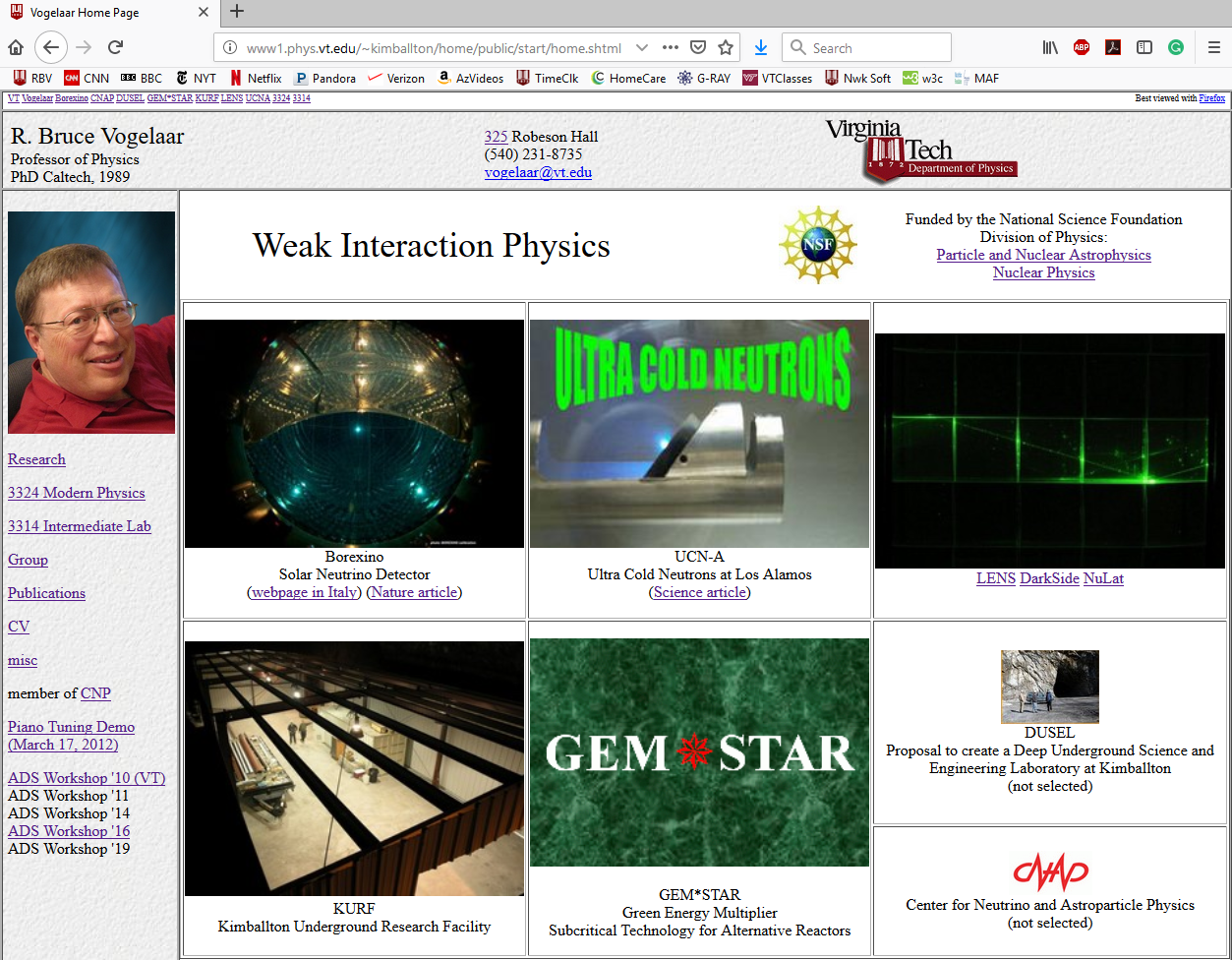

Slide 2
Borexino

Slide 3
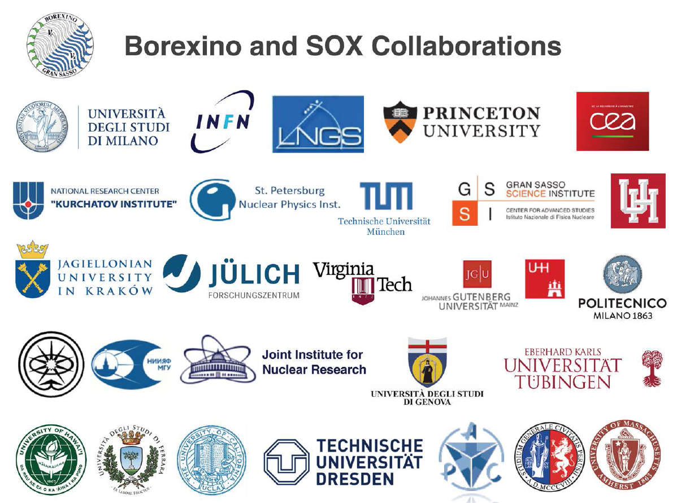

Slide 4
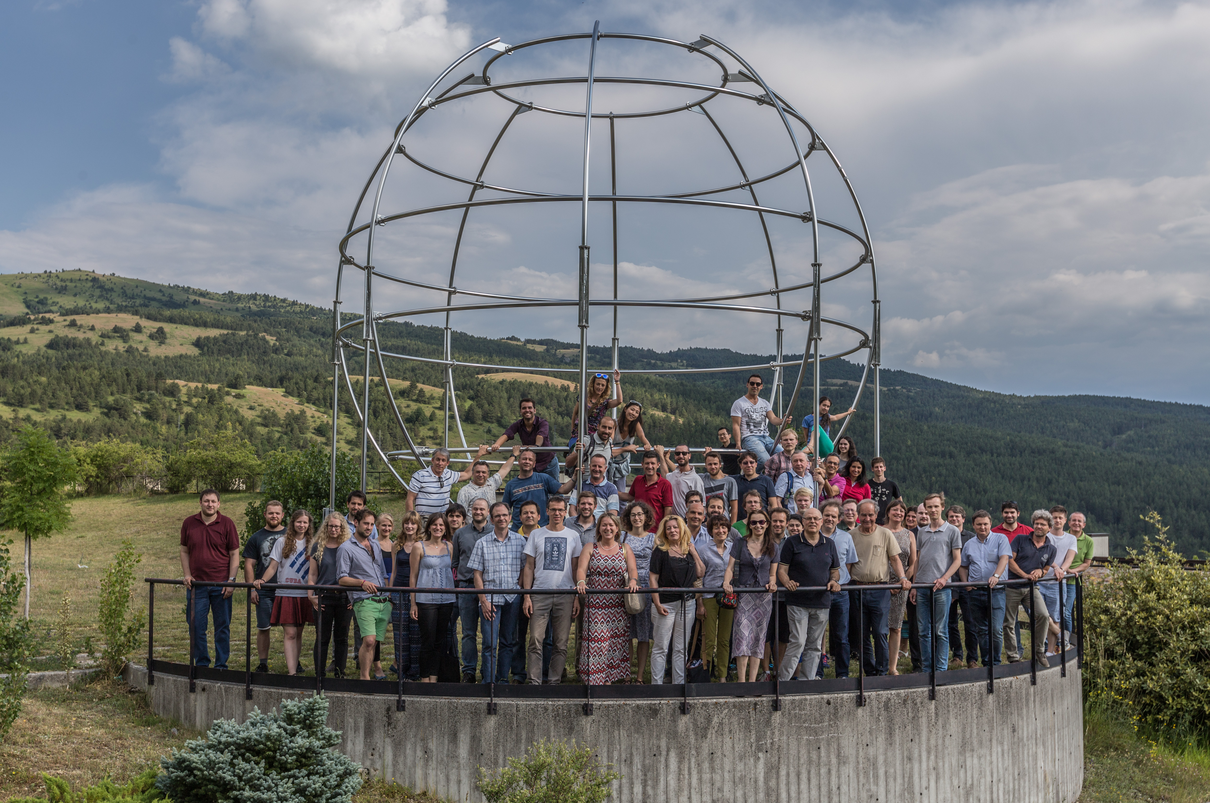

Slide 5
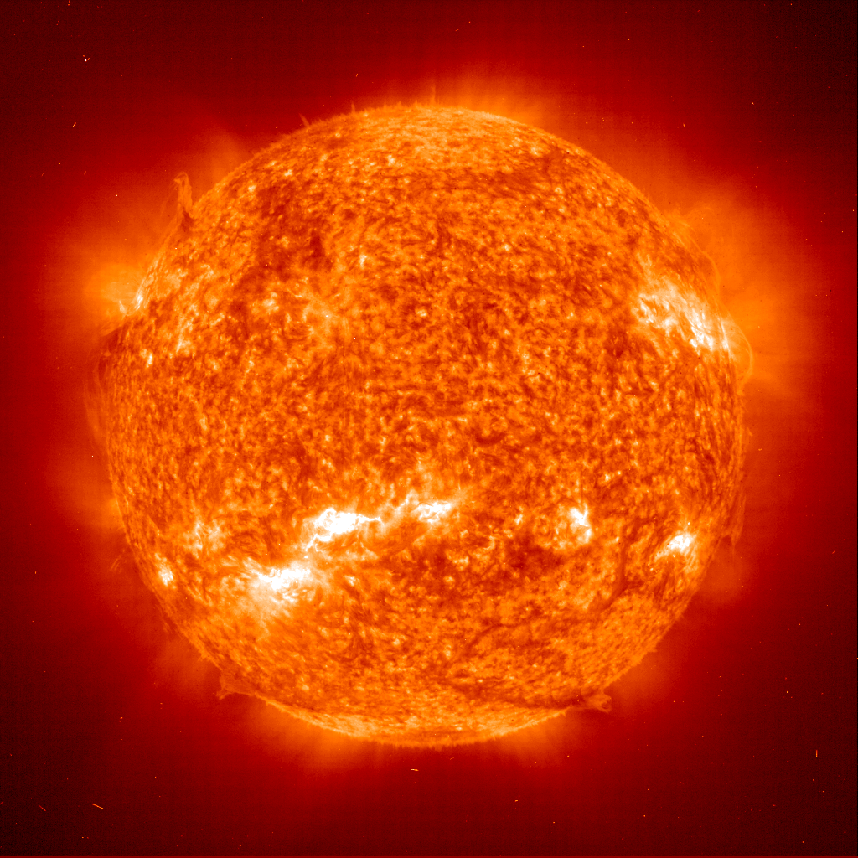
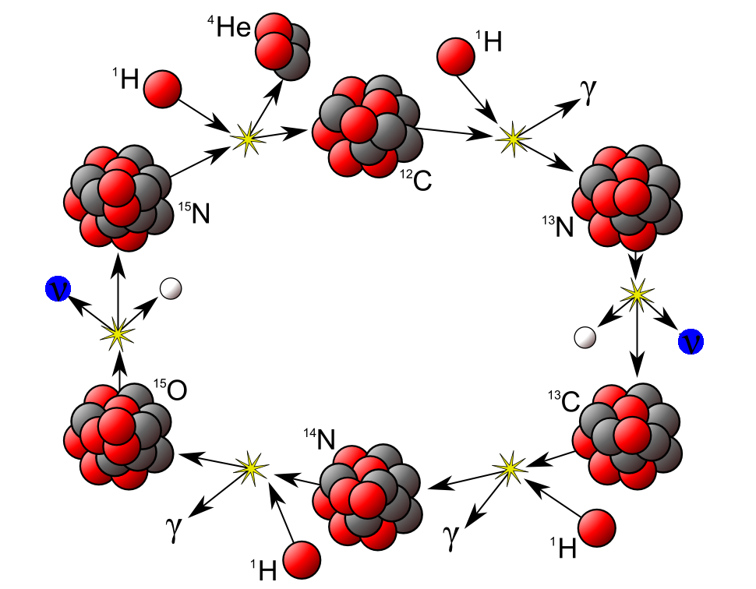
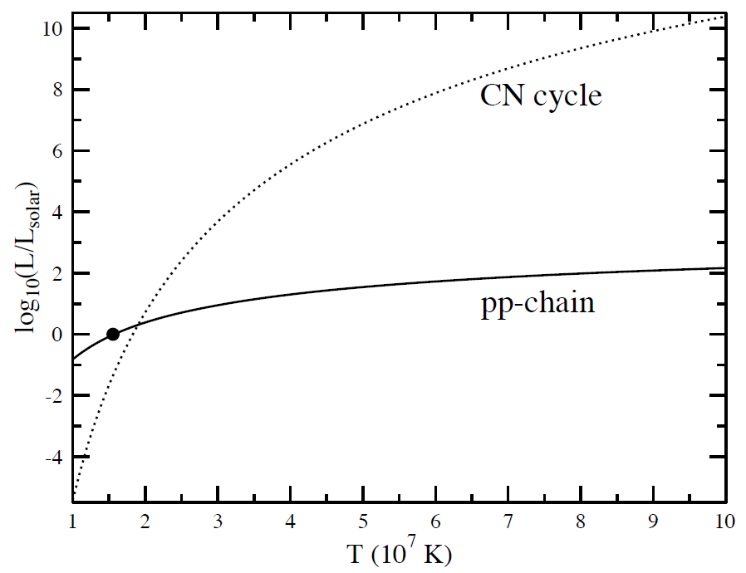
4₁H₀ → ₂He₂ (+2e⁺ + 2ν_{e})
CNO chain:
¹³N, ¹⁵O, and ¹⁷F neutrinos

Slide 6
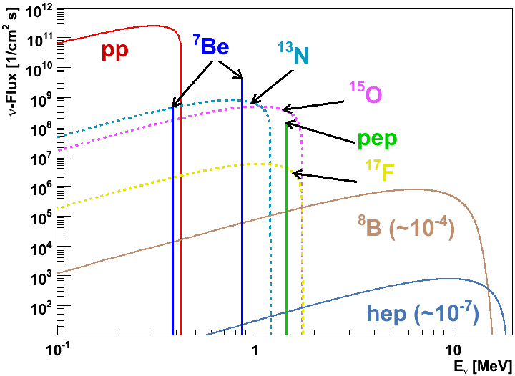

Slide 7
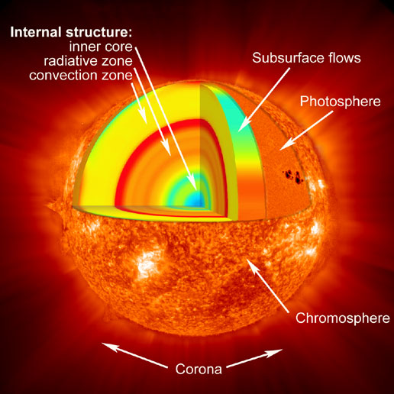
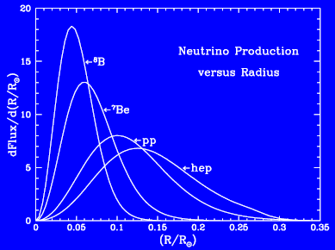

Slide 8
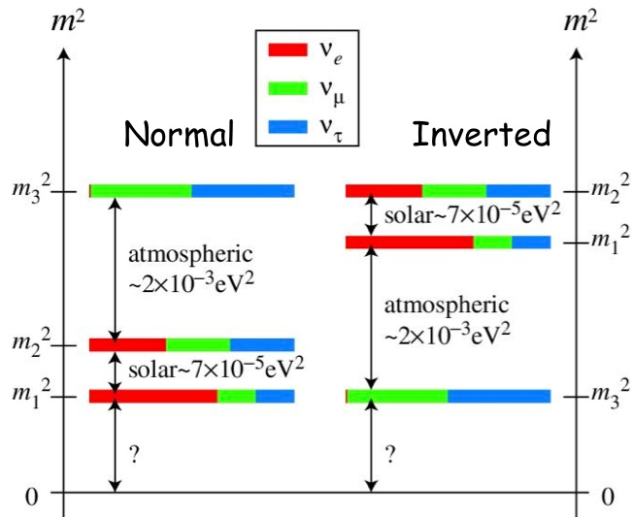

Slide 9
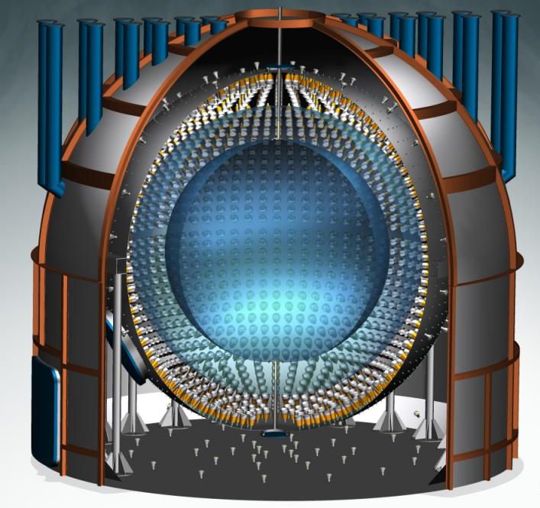
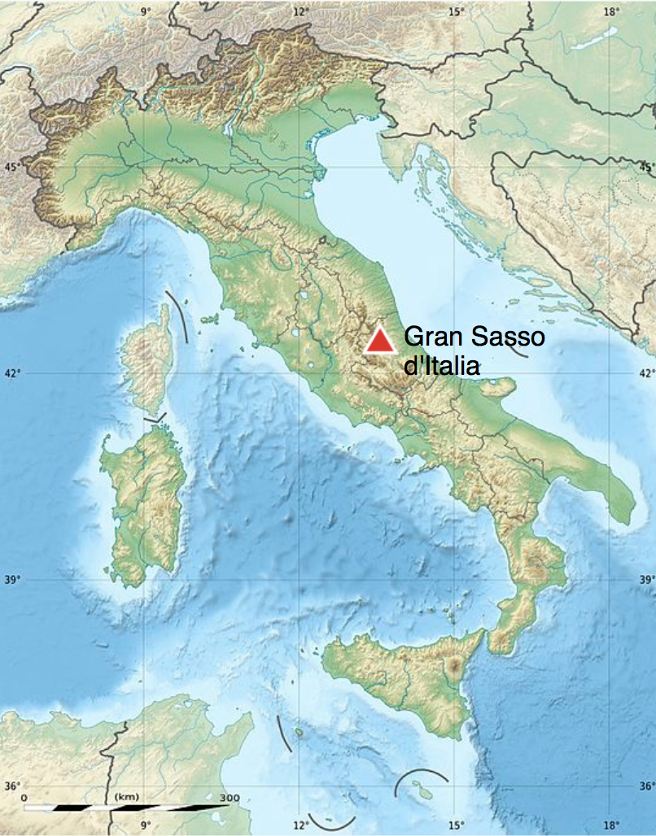

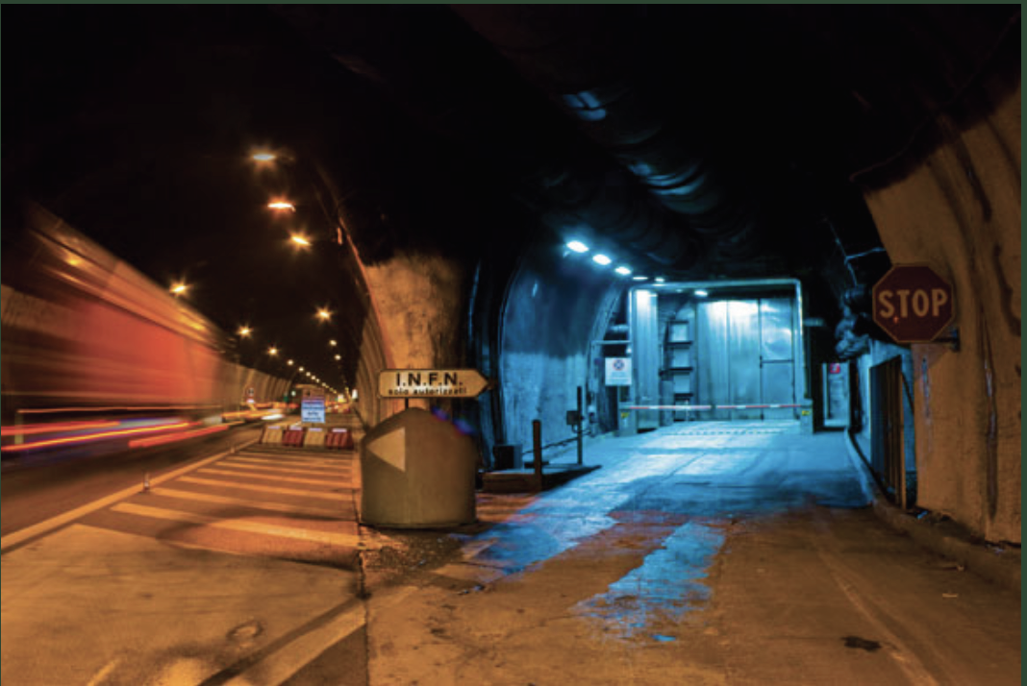
BOREXINO @ LNGS
Borexino detector at Hall C
Laboratori Nazionali
di Gran Sasso
3800 m.w.e shielding
against cosmic rays
Gran Sasso, Apennines,
Abruzzo, Italy
Entrance to the LNGS

Slide 10

BOREXINO Detector
Detection principle:
elastic scattering on electrons
Technique advantages:
high light-yield
Technique disadvantages:
no directional information
2212 inward-facing
PMTs
Nylon Outer Vessel
R = 5.5 m
Barrier for Rn
from steel, PMTs etc.
Water tank:
R = 9 m, 2.1 kt of water
Shielding
Cherenkov muon veto
Nylon Inner Vessel
R = 4.25 m
~ 300 tons of
liquid scintillator:
(PC/PPO solution)
Stainless Steel Sphere:
R = 6.85 m
Scintillator container
PMTs support
Fiducial volume:
~100 tons (software cut)
208 Outer Detector PMTs

Slide 11
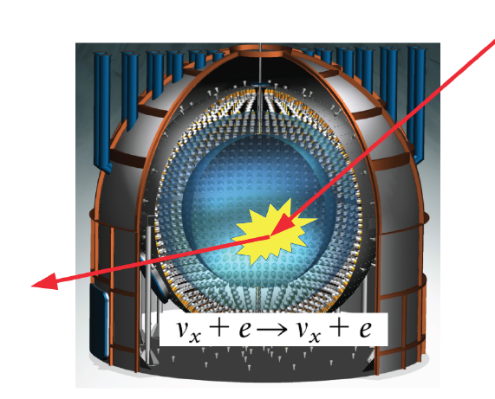
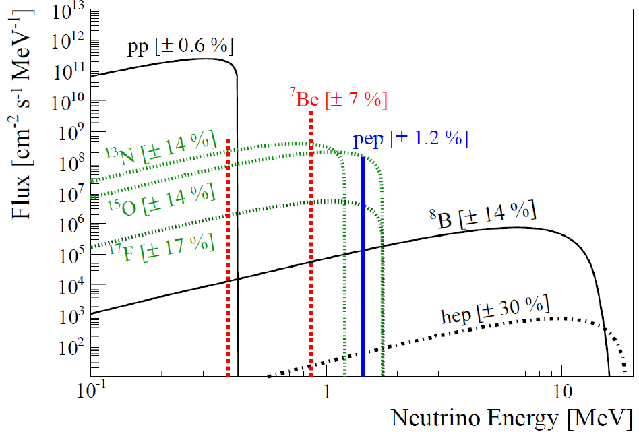
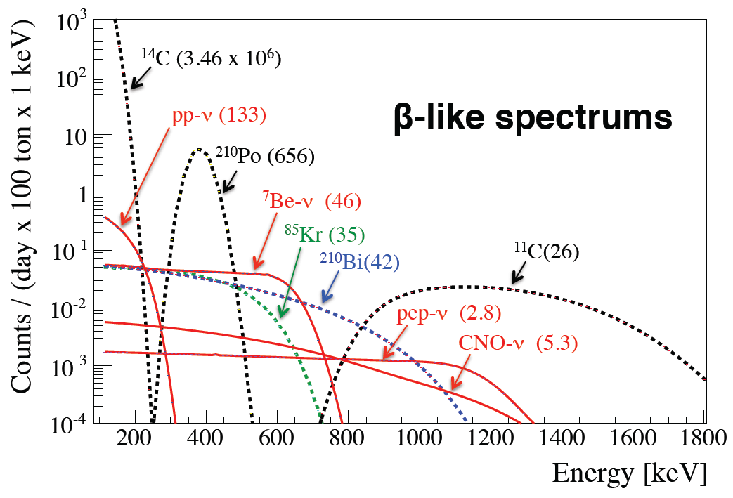
Scintillator distilled during initial filling.

Slide 12
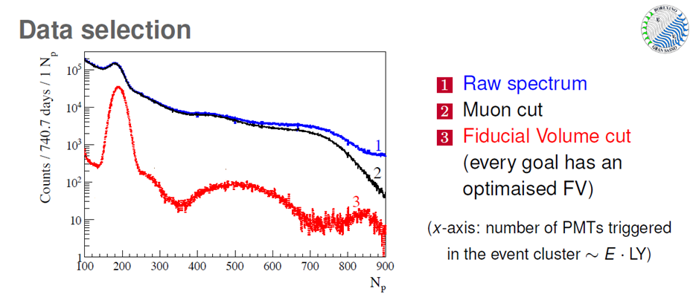
optimized

Slide 13
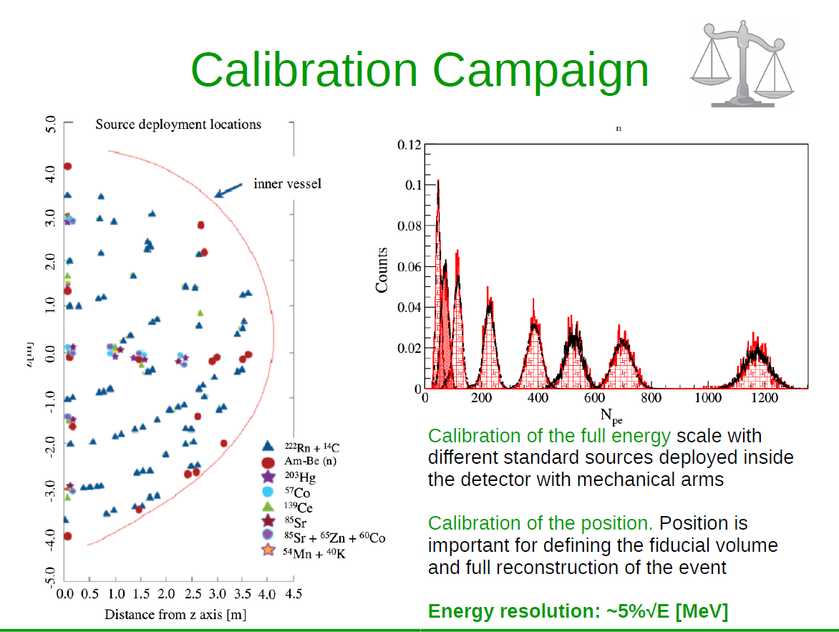

Slide 14
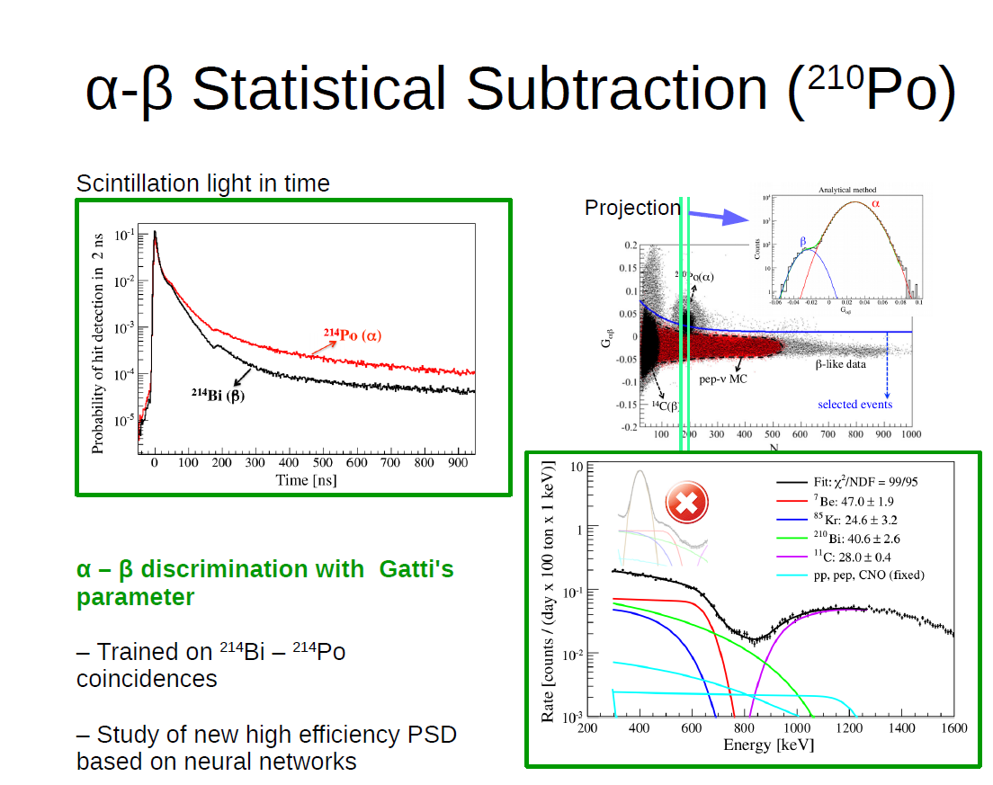

Slide 15
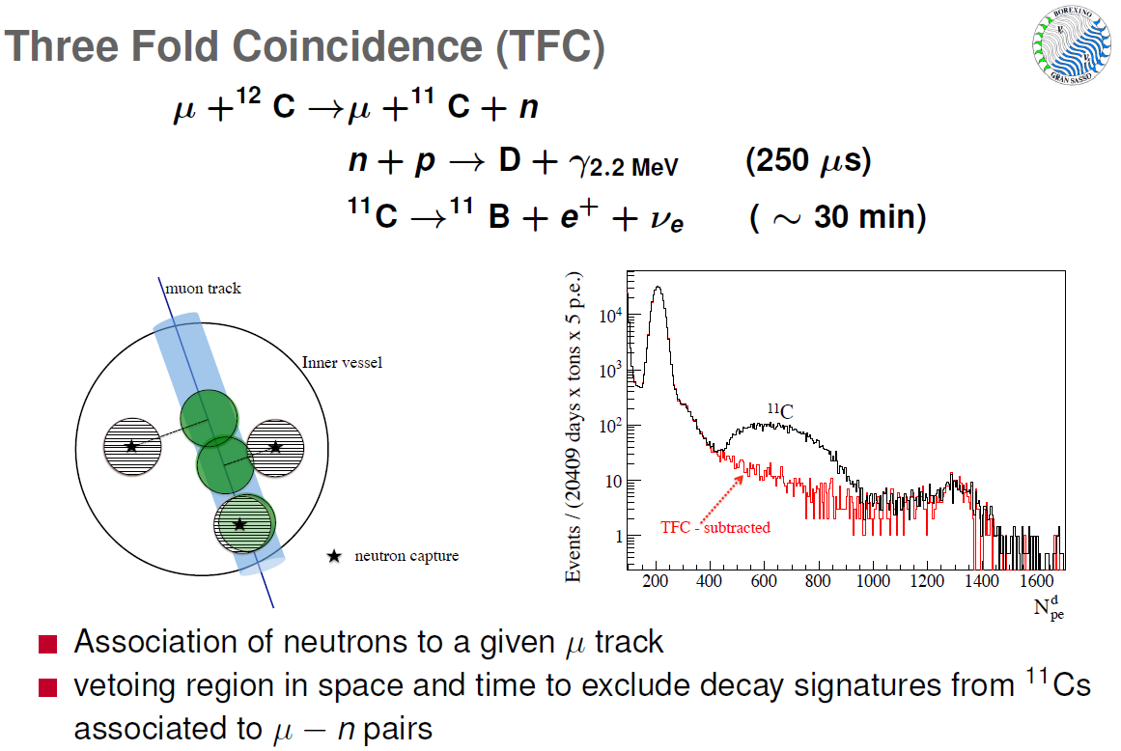

Slide 16
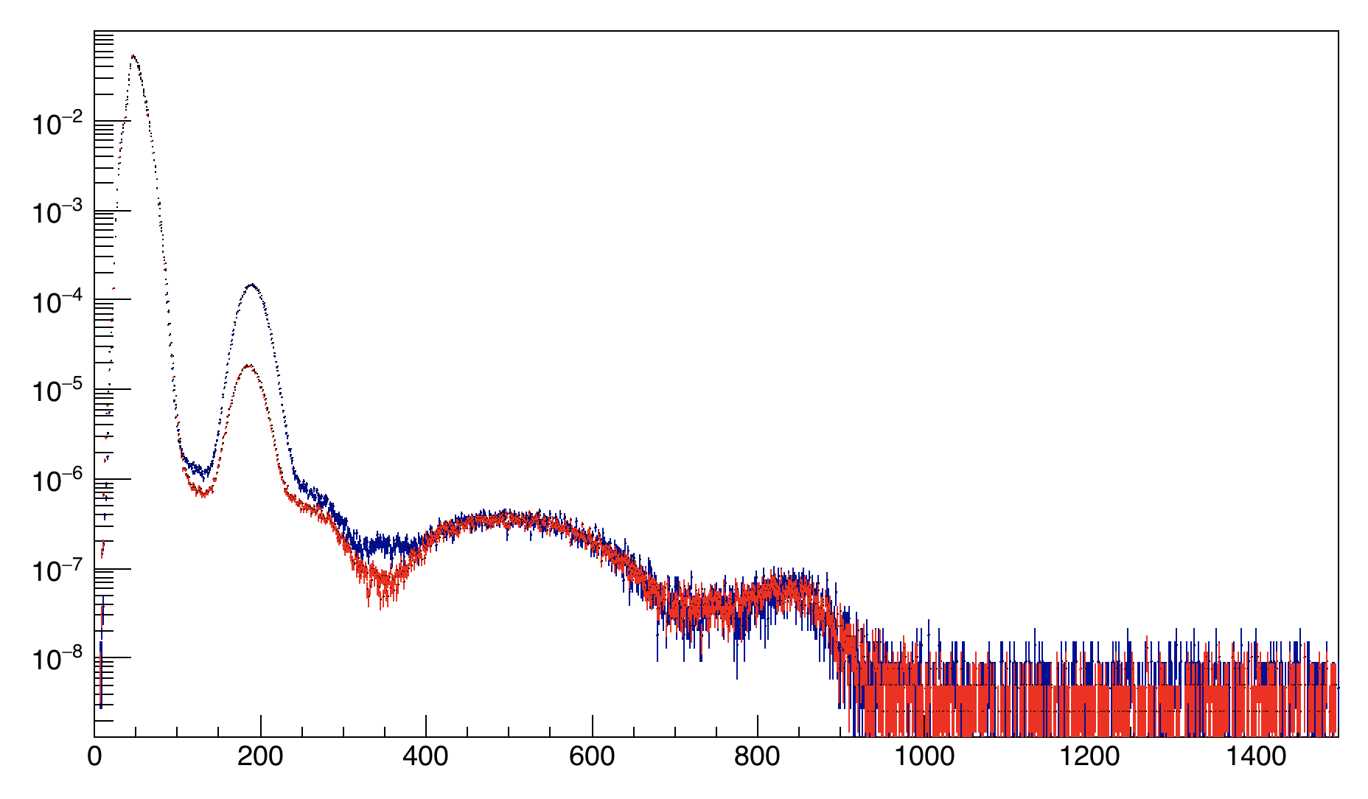
¹⁴C unavoidable in organic scintillator
Phase I (2007-2010)
Phase II (2012-2017)
²¹⁰Po
pp
¹¹C
⁷Be
¹¹C
External Background
pep, CNO
NPMTs

Slide 17
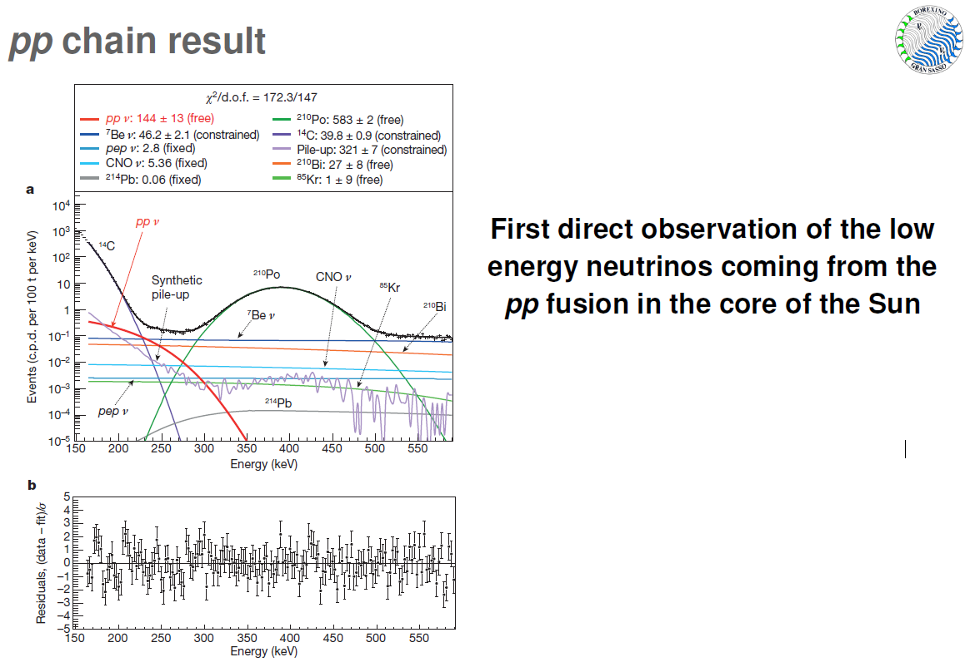
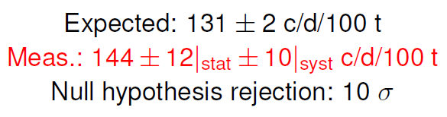

Slide 18
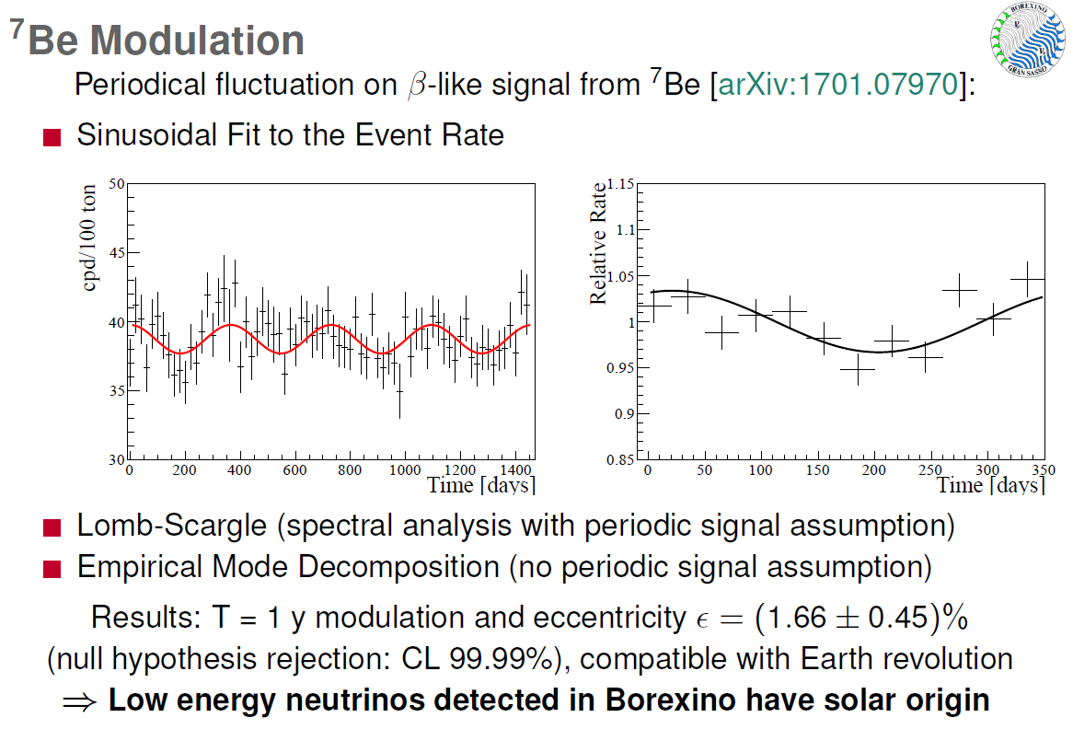

Slide 19
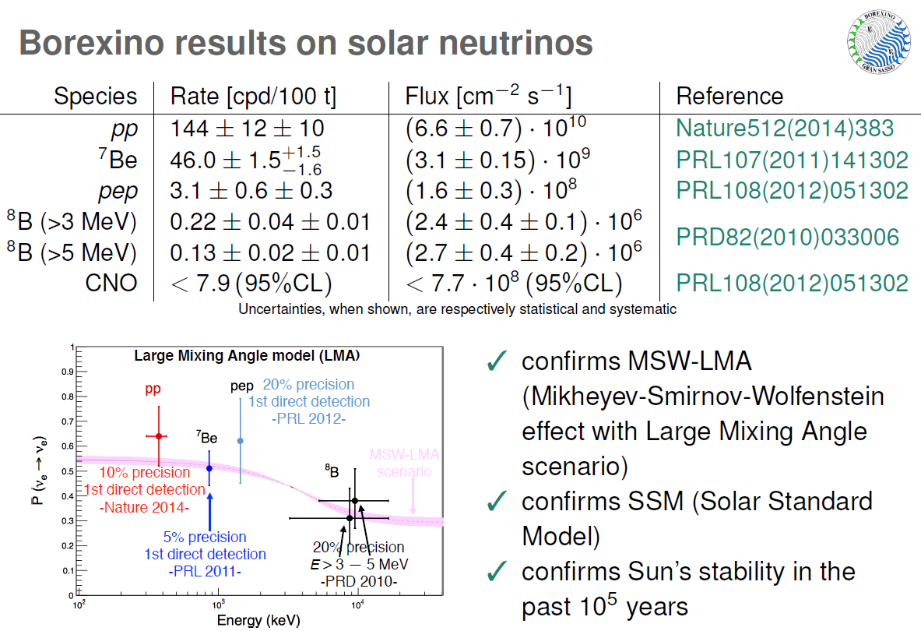

Slide 20
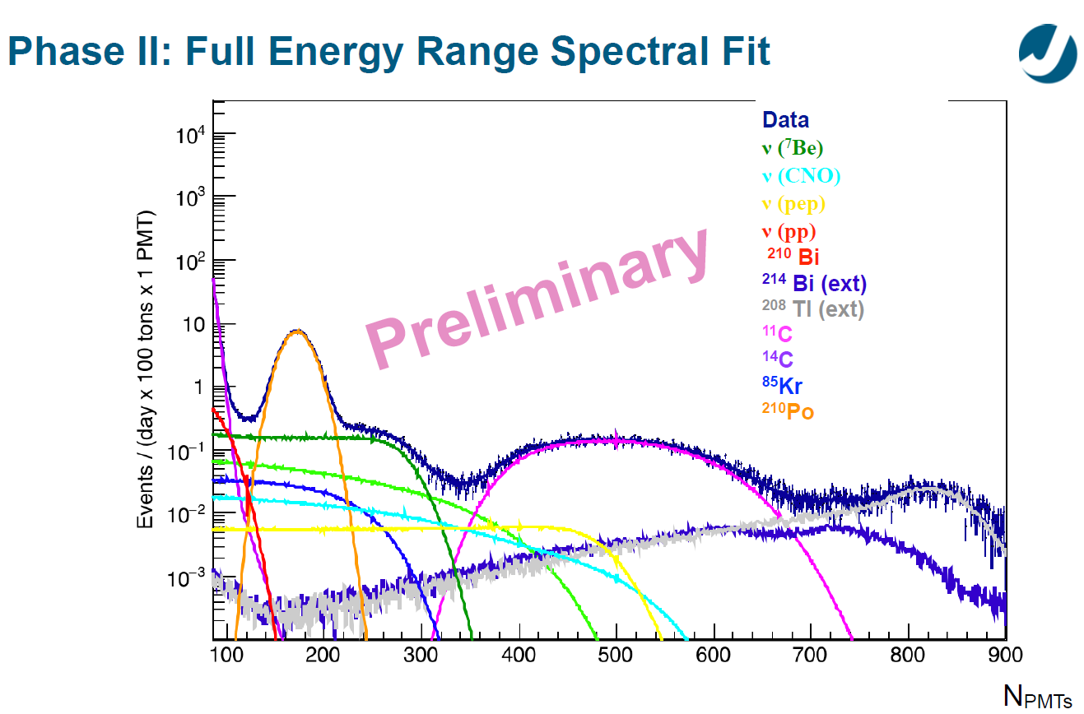

Slide 21
Having arguably the lowest radioactive background detector on Earth, we are trying to directly measure the CNO neutrino flux.

Slide 22
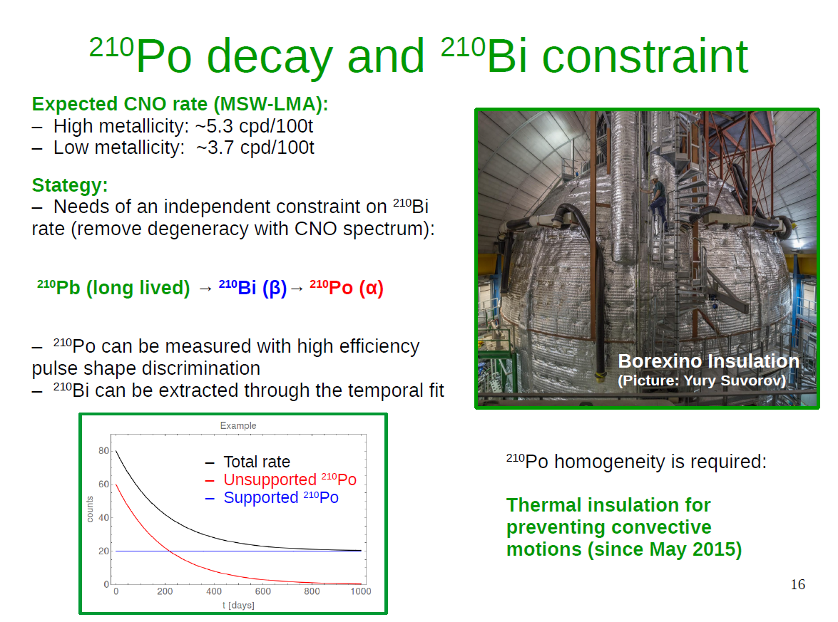

Slide 23
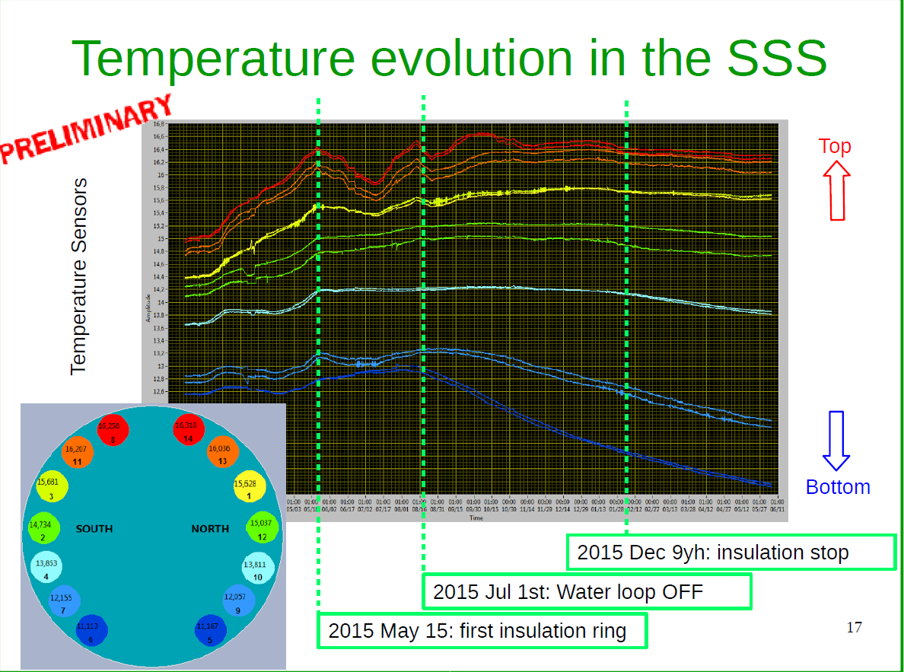
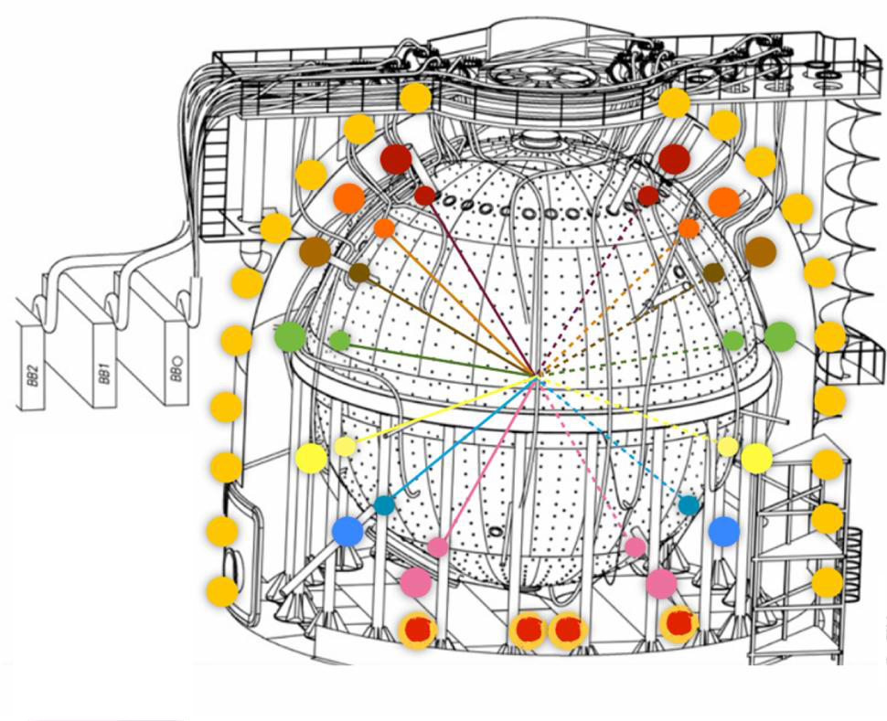

Slide 24
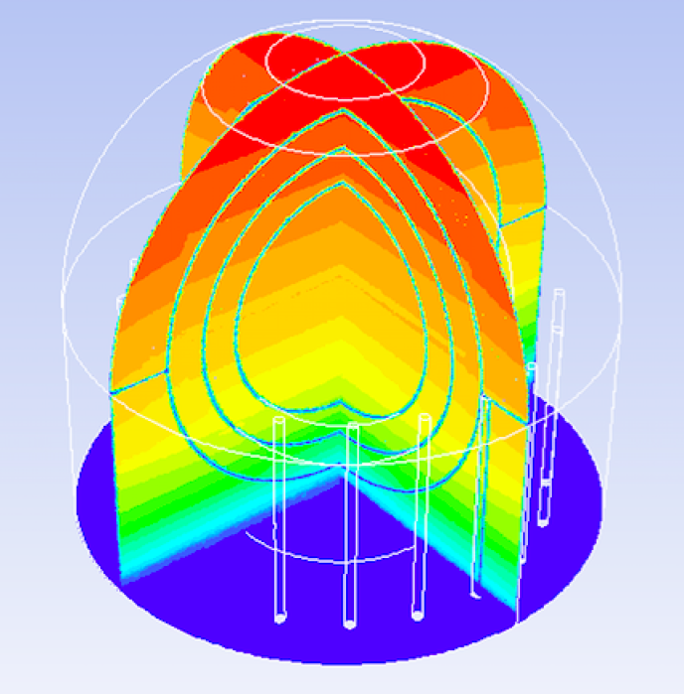
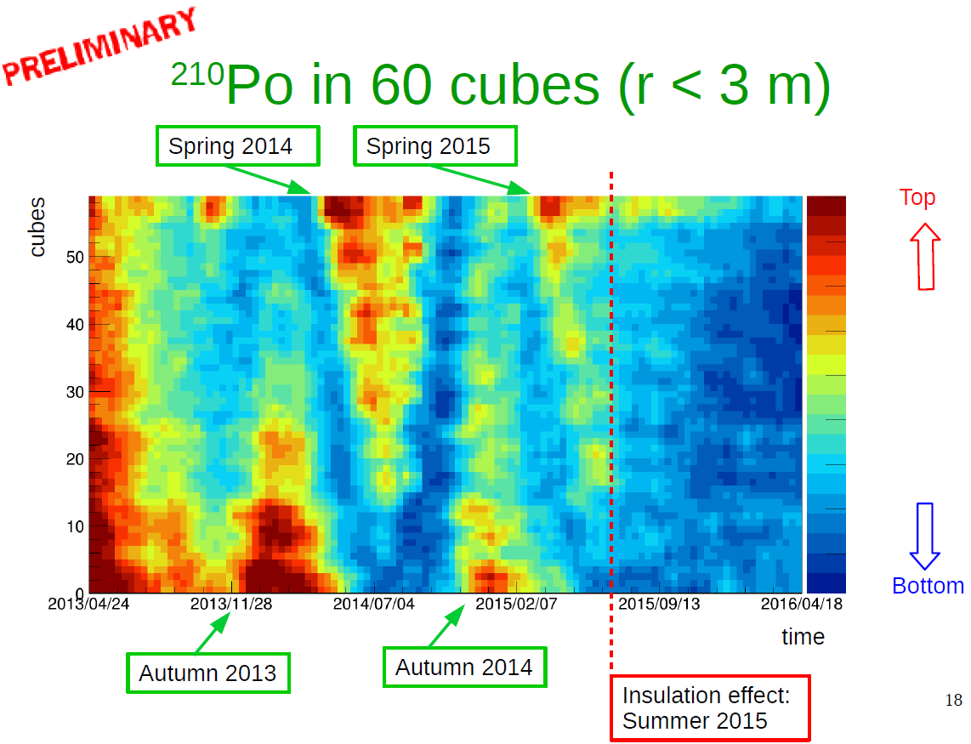

Slide 25
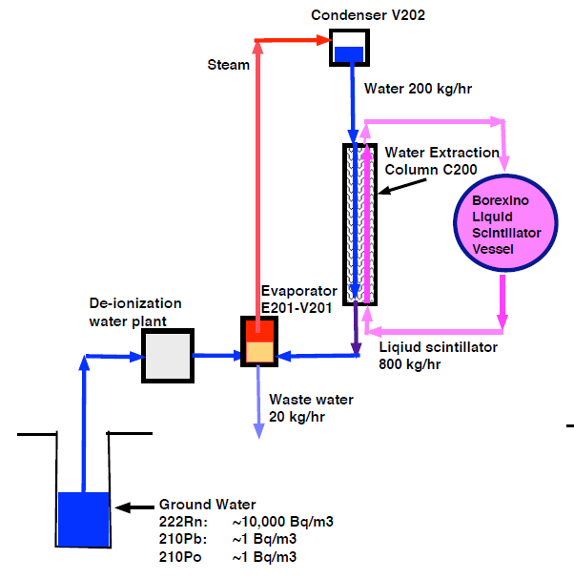
Upgraded water purification plant ready, based on discovery of volatile organic Po compounds (and maybe Pb). Best bet for fundamentally reducing ²¹⁰Bi background.
Upgraded…
¹⁴C unavoidable in organic scintillator
Phase I (2007-2010)
Phase II (2012-2017)
Phase III (in planning)
²¹⁰Po
¹¹C
External Background
NPMTs

Slide 26
VT: Internal Calibration, Thermal Stabilization and monitoring, Data Analysis, (purification potentially)

Slide 27
Darkside

Slide 28
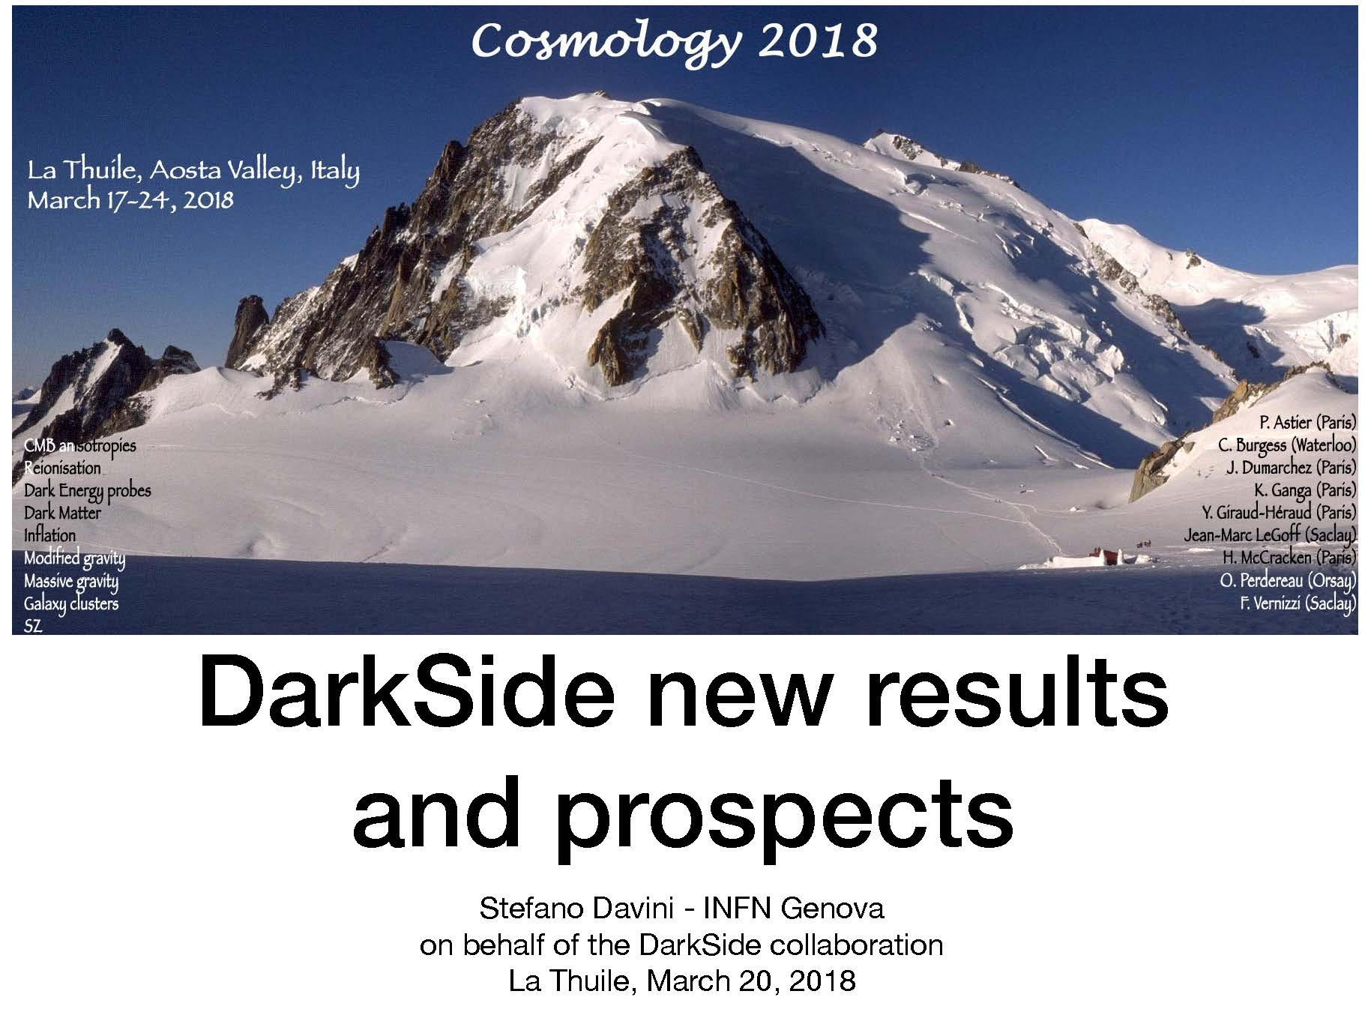

Slide 29
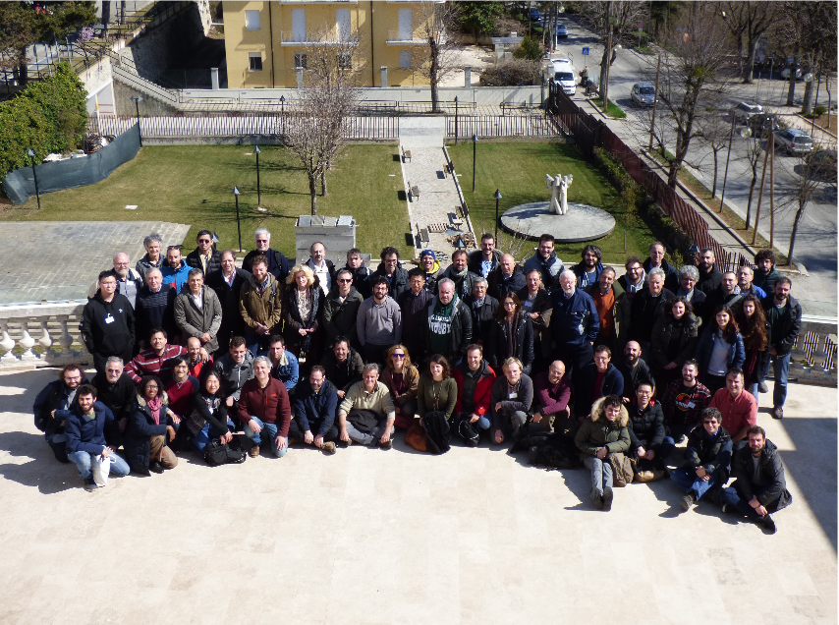

Slide 30
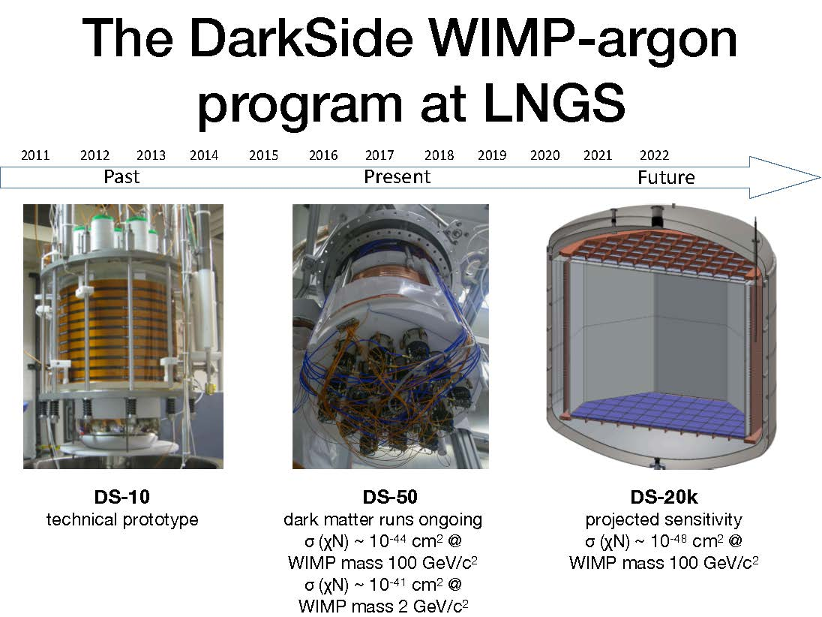

Slide 31
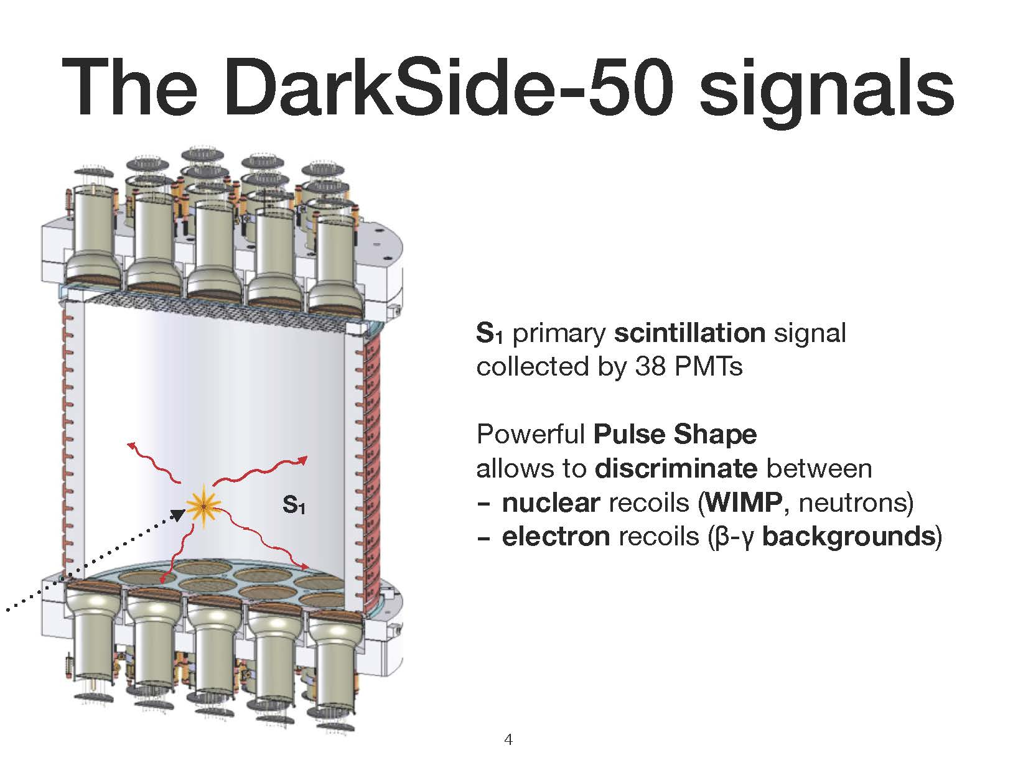

Slide 32
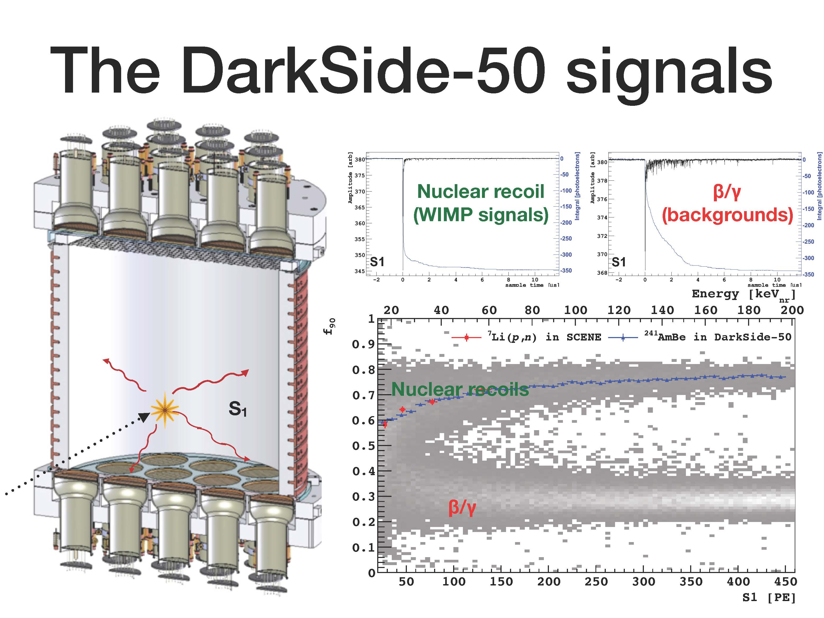

Slide 33
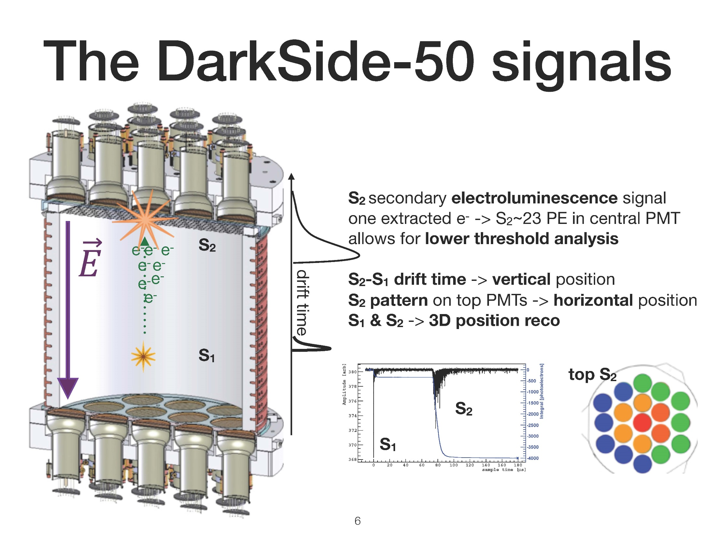

Slide 34
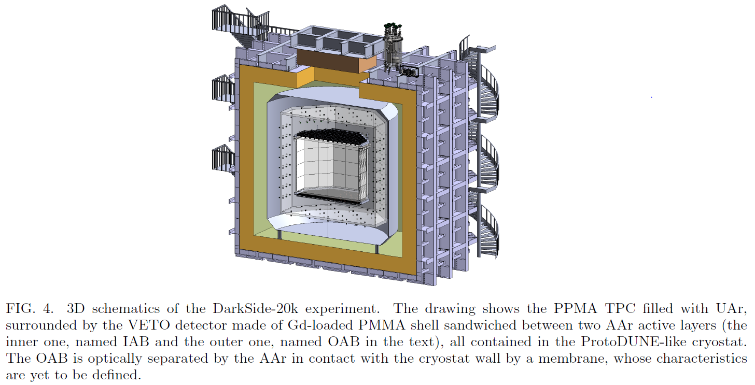

Slide 35
Virginia Tech is responsible for
supervising the design, construction, instrumentation and subsequent operation of the facilities in Gran Sasso for annealing and coating the acrylic components of the TPC and veto detectors.
The Virginia Tech group will also develop, test, and incorporate into the DS-20k detector instrumentation and software to collect, monitor, and log long-term mechanical, environmental, data-flow, and slow-control systems. This will include integration with the calibration systems.

Slide 36
nUlAT
Neutrino Lattice

Slide 37
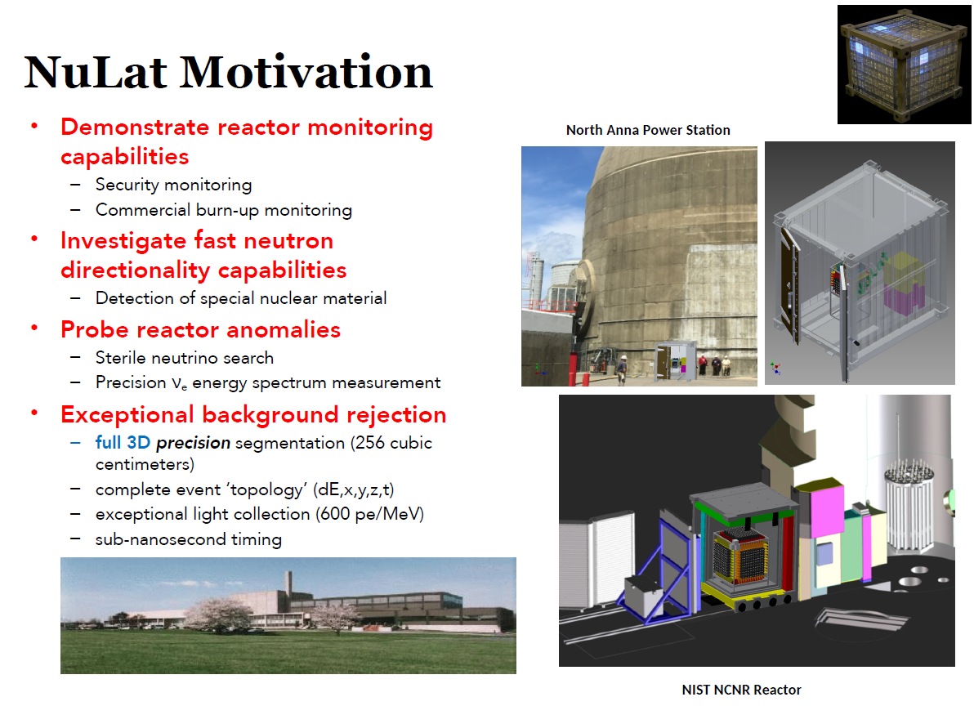

Slide 38



Classic ${\overline{υ}}_{e}$Signature
NEW: ⁶Li loaded plastic scintillator
Cherepy NIM A778 2015
n
(+ ⁶Li → ⁴He + ³H + 4.8 MeV)
localized 400 keV_{ee}
IBD
(Inverse Beta Decay)
$${\overline{υ}}_{e}$$
e⁺ annihilation
prompt
delayed
time

Slide 39
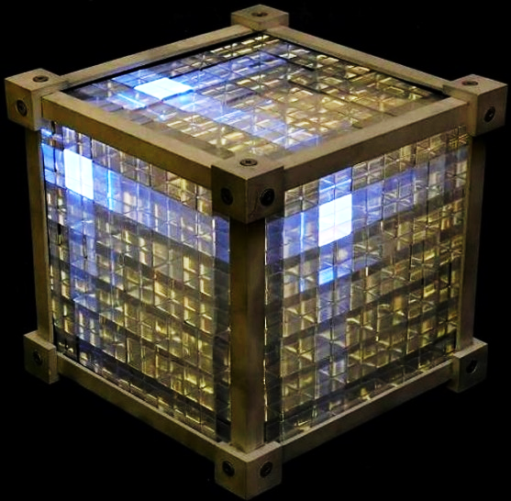
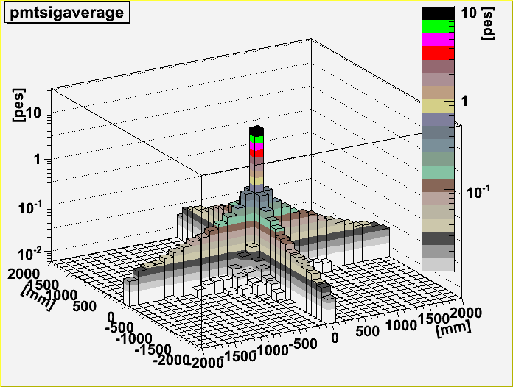
NEW: Raghavan Optical Lattice
light channeling via total internal reflection
full 3D light collection along principle axes

Slide 40
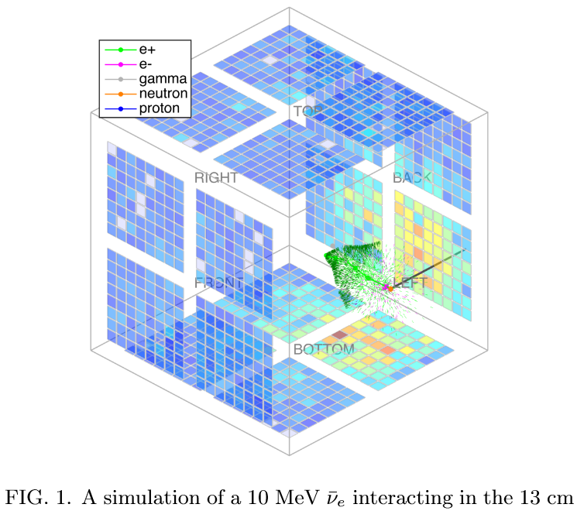
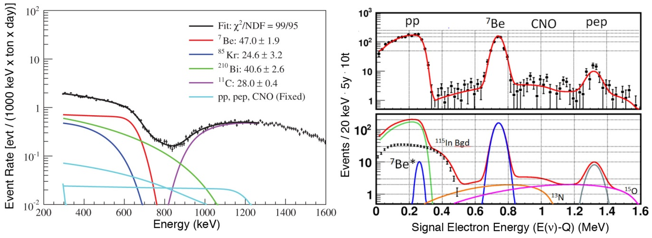
Merger of Existing Work
LENS
  NSF supported R&D
  solar neutrino spectrum
  segmentation and event topology
TimeCube
  DOE, NGA supported R&D
  neutrino detection and fission neutron directional detection
  very fast (< 0.1 ns) electronics

Slide 41
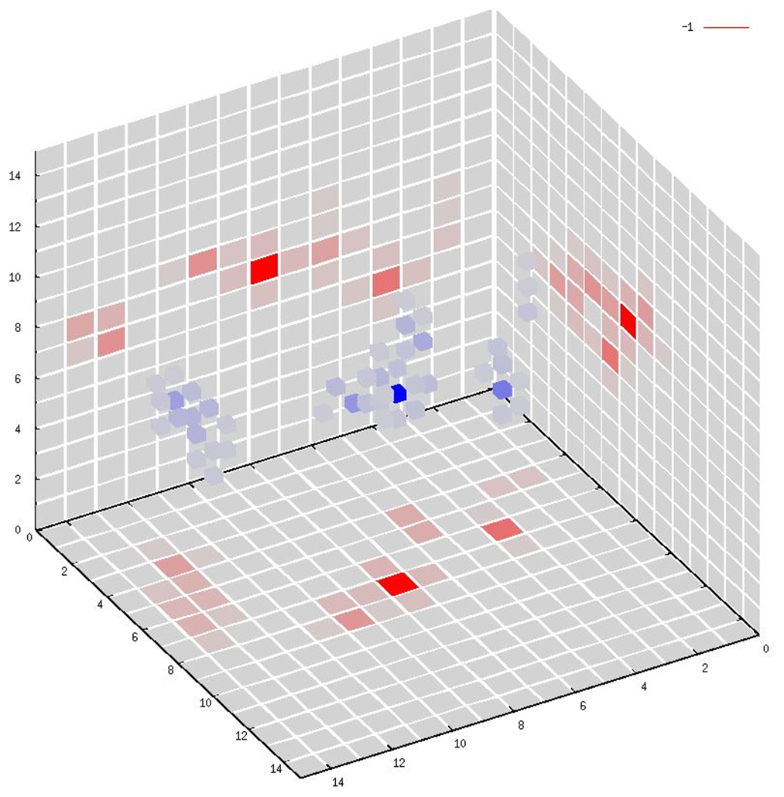
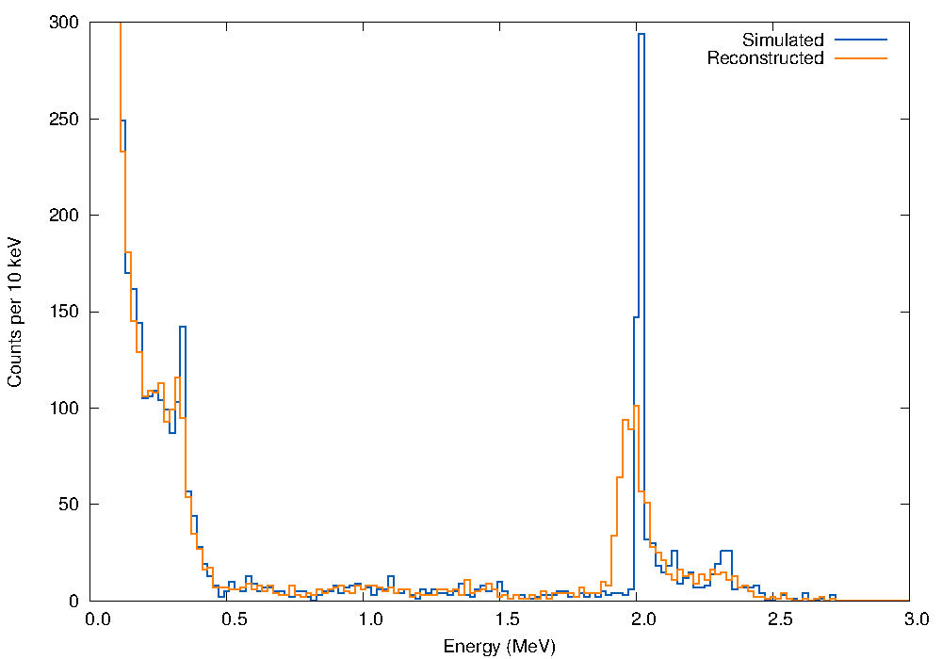
Event Topology
<4%/$\sqrt{E} ($>600 p.e. /MeV)
single cell position (< 3 cm w timing)
effectively 15³ individual high-resolution detectors, giving complete event topology
Reconstruction of a typical
2 MeV positron event.
note: 3D allows digital separation of events along channel
Average single-cell prompt response to a uniform 3.8 MeV anti-neutrino flux.
no fiducial cut

Slide 42
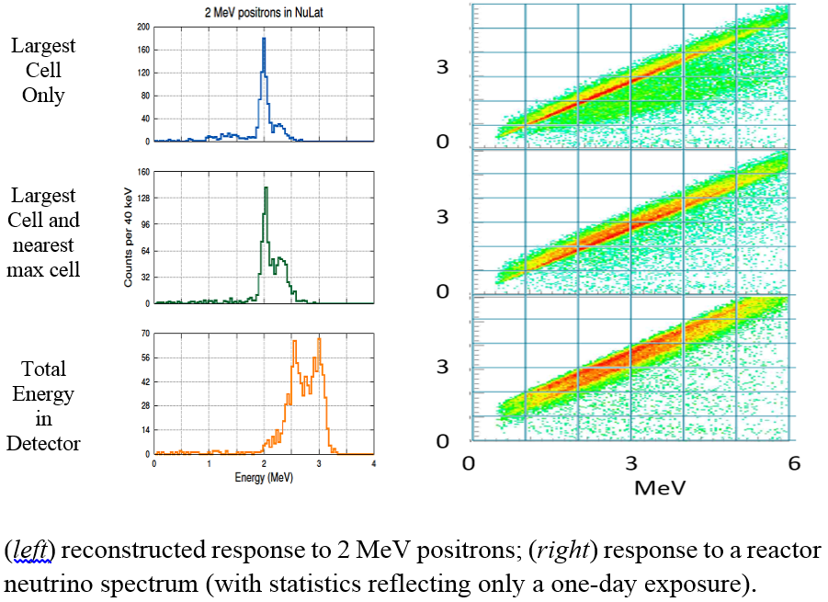
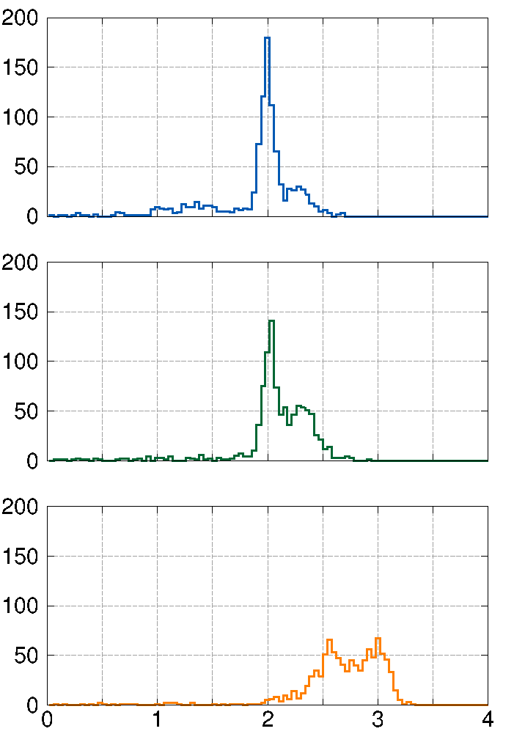
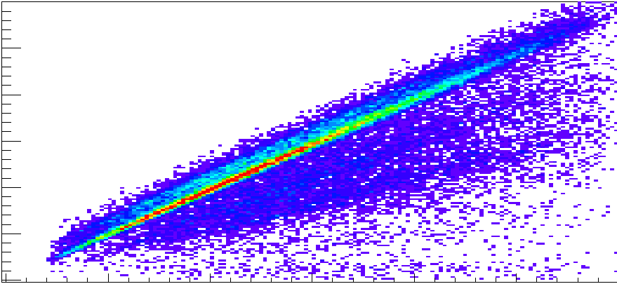
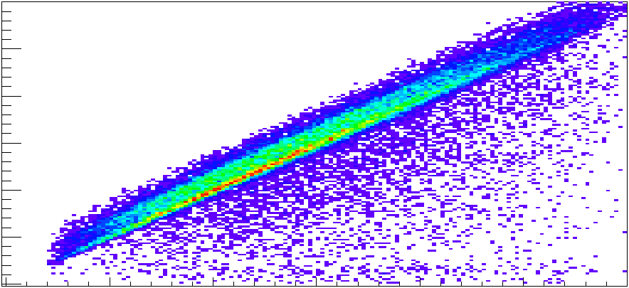

Energy Resolution
→ full positron energy in one cell (or at most two)
→ minimal contamination by annihilation gammas in positron cell
→ allows excellent neutrino energy resolution throughout complete detector
unique to NuLat →
available to all integrating small detectors →

Slide 43

Distinguishable Stop Signal
Lithium-6
  ${}_{}^{6}{Li}+n→ {}_{}^{3}{H+α}$
  15 μs time correlation
  940 b
  mono-energetic ~400 keV_{ee}
  single cell stop tag
  n/gamma separation
  23% n capture in same cell as positron
  60% n capture in same cell as positron plus the six facing cells
  clean trigger: single cell, unique energy, neutron pulse-shape
typical particle ID possible in our plastic
Cherepy NIM A778 2015
Better energy resolution gives better background rejection.

Slide 44
Distinguishable Start Signal
Positron plus annihilation
  large single cell (or two), small halo (0.1-1.0 MeV total), in that time order
  rejects most gammas (primary reduction via passive shielding when close to reactor)
    single Compton within detector with no halo
    multiple Compton within detector with too large a halo
    single P.E. effect with no halo
  rejects most cosmogenic backgrounds
    pulse-shape discrimination rejects fast neutrons
    ⁹Li, ⁸He are β⁻ emitters with no annihilation halo
  pair production reduced by primary shielding and statistically by directionality

Slide 45

Systematics
Precision wall-free isotropic segmentation
  uniquely allows digital ratios to benchmark detector response
  critical when trying to
  quantify spectral
  features
Readily Movable
  allows multiple baselines on short time-scale
  allows easy transport to multiple reactor sites

Slide 46





NuLat detector assembly – Spacer dot
Every cube has some small dots on it as spacer to creat air gap between each cube. These dots are made by cutting from a strip of vm-2000 with double sided tape already on one side.
Enough gap for total internal reflection is checked by aligning cubes vertically together and checking whether there is Newton ring or not.

Slide 47



NuLat detector assembly – Cube assembly
Notes:
Start one cube
Tape the edge
Center the box

Slide 48





NuLat detector assembly – light guide coupling with PMT
Light guide is designed to increase light collection from square shape scintillator to circular photo cathode.
A small frame was made to help assemble PMT with light guide to keep the mounting centered and solid.
Notes:
Light guide
Square to circular
25 -> 50 more

Slide 49


NuLat detector assembly – finished version
Blue Side
Orange Side
Green Side
Notes:
1. Finished version

Slide 50
VT: Hardware, air-gap windows, DAQ, Analysis

Slide 51

GEM  STAR
Green Energy-Multiplier
Safe-Technology for Alternative Reactors
Virginia Tech, May 18, 2018

Slide 52

Current ‘unlimited’, harnessed, energy sources:
solar, wind, fossil, and nuclear.
Nuclear alone has small mass,
high energy density,
small waste mass,
high capacity factor,
and produces no greenhouse gasses.
US sources:
Solar (1.3%), Wind (6.5%), Hydro (7.5%), Fossil (63%), Nuclear (20%)
Source | Energy density (MJ/Kg) | Ratio
Uranium | 80,620,000 | 1
Diesel | 48 | $$6×{10}^{−7}$$
Coal | 30 | $$4×{10}^{−7}$$
a new approach for clean civilian nuclear energy

Slide 53
Responsive to VT’s Destination Area Common Theme:
…the equitable distribution and availability of physical safety and well-being
…and access to crucial material and social resources
throughout the world’s diverse communities.
    Intelligent Infrastructure for Human-Centered Communities
    Integrated Security
    Data and Decisions
    Global Systems Science
“We must harness the power of nuclear energy on behalf of our efforts to combat climate change, and to advance peace opportunity for all people”
Barack Obama

Slide 54




Basic Fission Chain Reaction
1st generation
$$N_{1}=kN_{0}$$
n’th generation
$$N_{n}=k^{n}N_{0}$$
$$N_{0}$$
$$k=\frac{\#fission neutrons in one generation}{\# of fission neutrons in the preceeding generation}$$
Reactor Physics Condition | k
Super-Critical | > 1
Critical | 1
Sub-Critical | < 1

Slide 55
GEMSTAR
Accelerator-Driven (Subcritical) Molten-Salt Fueled Reactor
A subcritical reactor needs an external neutron source:
An accelerator generates the needed neutrons
Beam of accelerated Protons
Target
Molten-Salt fuel

Slide 56
Has this been tried before?
Accelerator Transmutation of Waste (ATW)
1991-2007 DOE development program at LANL (~$280M/yr)
“Energy Amplifier”
Carlo Rubia (Nobel Laureate) Science 1993
(using Bowman ideas at LANL)
cited concerns | accelerators add complexity & cost accelerator performance (e.g., thermal shock rate) unpredictable licensing path

Slide 57



GEMSTAR
Molten-Salt Fueled Reactor
Has this been tried before?
Proven in 1960’s ORNL MSRE reactor using Modified Hastelloy-N
Ran on fission of ²³⁵U, ²³⁹Pu, ²³³U
Uranium or Thorium fluorides form eutectic mixture with LiF salt.
All current startups are focused on critical molten salt reactors.

Slide 58

NEW: merge accelerator and molten-salt fuel,
not as add-ons to existing systems, but in the original design:
Sub-critical buys us:
  Highly flexible fuel cycle
    removes challenges of maintaining ‘criticality’
    no enrichment required; no reprocessing (just fluorination)
    deeper burning of multiple fuels (including LWR spent fuel or WGPu),
    greatly reducing long-lived waste
  Intrinsically a safer regime of operation
  Economically viable today ($10^{6}$ reduction of cost to produce neutrons since 60’s)
Molten salt fuel buys us:
  Higher temperatures at lower pressures
  Lower pressure, easier & cheaper construction, less materials damage
  No concern about fuel melting
  Relieves accelerator ‘trip’ issues (no solid-fuel thermal shock)
  On-line refueling & removal of volatile fission products
Homologous target/core design buys us:
  Commercially viable performance
Thermal neutron spectrum:
  High tolerance for fission products (eliminates need for their removal.)

Slide 59


Change Paradigm for Nuclear Energy
US currently
stuck here
local storage
old
Enrichment
Thermal
Reactors
Reprocessing
Natural
Uranium
Fast
Reactors
Geologic
Storage
new
GEMSTAR
Natural uranium or
LWR spent fuel
Liquid Fuel
Recycling Reactor
With
supplemental neutrons
Geologic
Storage
No enrichment, no reprocessing
End-of-life waste remnant reduced
by x10 and delayed by centuries

Slide 60

Timeline
Safety
Waste
Nonproliferation
Cost
Current Best Projections:
Cost
mostly proven, known costs
competitive with fossil fuel
simplified safety
reduced nuclear security cost
Nonproliferation
no enrichment required
no reprocessing (just fluorination)
Waste
greatly reduced long-lived activity
can run on LWR spent fuel (with bulk fluorination)
Safety
no concern for fuel melting (Accident Tolerant Fuel)
subcritical - no criticality accidents
reduced volatile radioactive inventory
low-pressure system
Timeline
no missing technology
reduced licensing time (system and public acceptance)
This is very unique to the GEM*STAR approach – addressing all at the same time.

Slide 61
US Nuclear Energy Generation - R&D & Construction
US Energy Context:
coal/natural gas: not ‘green’
solar/wind: baseload challenges
US Nuclear Energy Context:
3 reactors were under construction (GEN 3+ LWRs):
  2 in Georgia & 1 in Tennessee (completed)
New government and industry activities – Advanced Reactor Design
  Whitehouse Nuclear Energy Summit (Nov ’15)
  COP-21 climate talks (Dec ’15, Paris, France)
  DOE new opportunities for advanced reactor research (public-private partnership),
  $80 M (Funded, Jan 2016);
  Southern Co. to develop Molten Chloride Fast Reactor;
  X-energy to develop Xe-100 pebble bed HTGR
  Breakthrough Energy (investment group led by Bill Gates)
  DOE, Advanced Reactor Technologies, industry-driven projects, $30 M (Nov 2017)
  DOE, U.S. Industry Awards in Support of Advanced Nuclear Technology Development, $60 M (April 2018)
  DOE, in the next 6 months, ANT Development, $40 M (pending)
Startups (about 50), for example:
    TerraPower (Traveling Wave - Bill Gates) ; Terrestrial Energy (MSR in Canada); Flibe Energy (MSR LFTR – Sorensen); ThorCon Power (MSR [uranium fuel]); Moltex Energy (MSR – British); Transatomic Power (MSR – MIT); NuScale Power (SMR-LWR – DOE & industry supported); mPower (SMR-LWR– B&W); Kairospower (MSR Berkeley)
ALL are CRITICAL reactors

Slide 62
GEM*STAR – A Transformative Player
Confident basic design can be made to work.
  optimize design via full simulation and engineering
  study operation and failure modes
  confirm costing, performance, and commercial viability
  study sub-systems as part of ‘research stretch’
Determine best path to demonstration and financial backing.
  FUEL: Natural Uranium
  Weapons Grade Plutonium
  Existing LWR spent fuel
  USE: Synthetic transport fuel
  Electricity
  High-temp process heat
  Burning LWR spent fuel

Slide 63
Create a single purpose entity for clarity of mission to investors
Virginia Tech
Leverage VT Programmatic Interest
Time Y1 Y2 Y3 Y4 Y5 Y6-9 Y10+
VTF
University
Research/Academic
Investment:
VTF 5 yr staged
investment $4M
funding sources for companies
SBIR
DOE GAIN
NNSA
Corporate
Donor
Venture
Partners
etc…
GEM*STAR
(for profit)
Vogelaar
Haghighat
Project Manager
full design
Nucl. Eng.
Mech, Eng.
Chem. Eng.
MSE
Physics
Chemistry
Geosciences
Sustainable Biomaterials
Public & International Affairs
(other depts.)
Destination Areas
Institutes
funding sources for university research
DOE
NNSA
NSF
Foundations
etc…
close
partnership
help draft solicitation
help draft solicitation
Build and Operate Demonstration Plant
Help Facilitate
Demonstration Plant
diesel fuel
WGPu use
LWR spent fuel use
tritium production
electricity gen.
process heat
(domestic and international)
Large ROI to VTF
molten-salt materials
high temp turbines
nuclear policy
global energy policy
cheaper green-energy
neutronics
accelerator design
“research stretch”
Outcomes:

Slide 64
Pu Weapons
Small time window (during maximum compression) for full yield:
no ignition ⇔ pre-ignition
(probability depends on rate of spontaneous fission)
timed ignition
  (engineered pulse of neutrons)
Pu amount and isotope distribution matters…

Slide 65
FB BN800 MOX-LWR GEM*STAR
²³⁹Pu | α | 24,110 years
²⁴⁰Pu | α,sf | 6,561 years
²⁴¹Pu | β | 14.325 years
²⁴²Pu | α,sf | 373,300 years

Slide 67
GEM*STAR: First Tier External Studies
Topic | Potential respondents
Core and Target Simulation | ORNL
Syn-Gas production | Schnabel Engineering
1GeV protons @ 1, 2.5 and 10 MW | Muons Inc
Neutrons in Graphite | NCCU
Molten Salt Chemistry & Pumping | VT, ORNL, INR (Russia)?
WPu treaty compliance | LLNL, NNSA
Core Interior Design | ADNA, Georgia Tech
Target Development and Testing | LANL
IP & Regulations | GWU,FGA Group
Failure Mode Analysis | Bechtel
Integration with Naval Operations | VT, GWU, ONR (NRL)
System Integration | VT-ARC?

