Slide 1
Using Mathematica to create interactive Physics apps
Tatsu Takeuchi
Virginia Tech
Oct. 24, 2020 @ cSAAPT Virtual Fall Meeting

Slide 2
Mathematica
Most 4-year Universities and Colleges have site licenses that provide free access to faculty and students
Educational pricing available: Educators (personal) : subscription $124/year, or purchase $248 Students (personal) : subscription $83/year, or purchase $166
Apps created on Mathematica can be played on Wolfram Player, which can be downloaded for free from: https://www.wolfram.com/player/
Many useful features for teaching Physics:
Can create figures, animations, interactive apps
Can generate sound

Slide 3
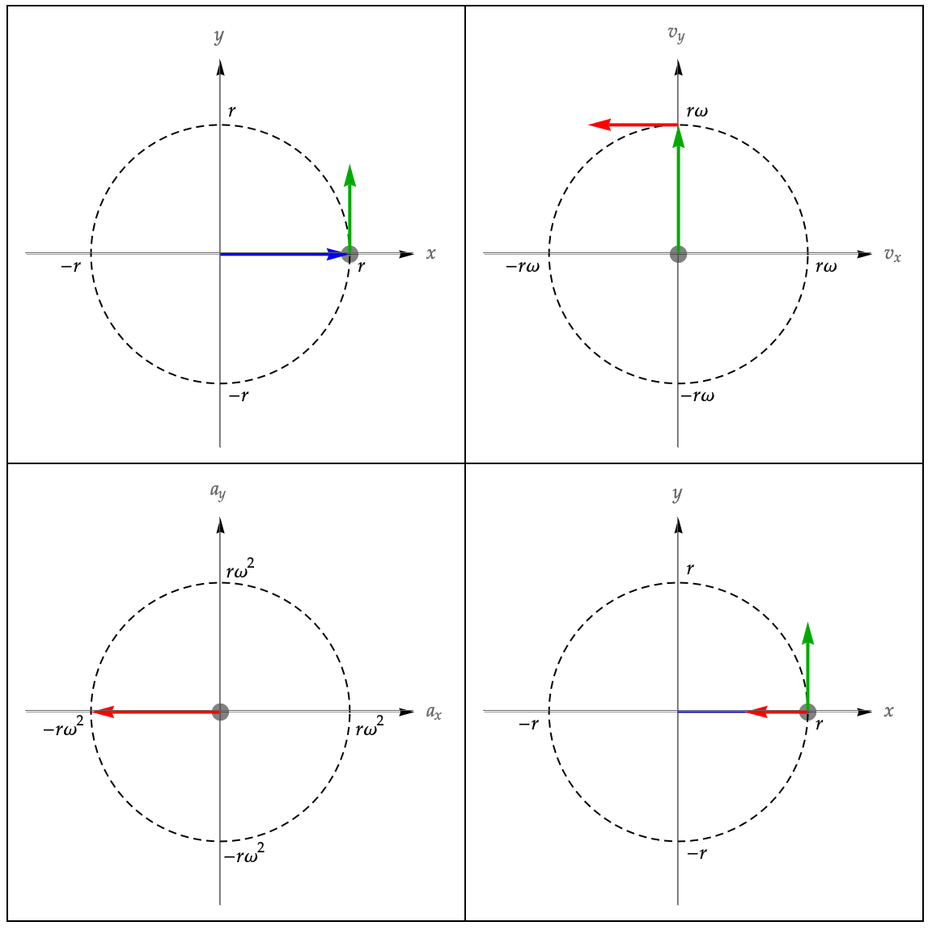

Slide 4
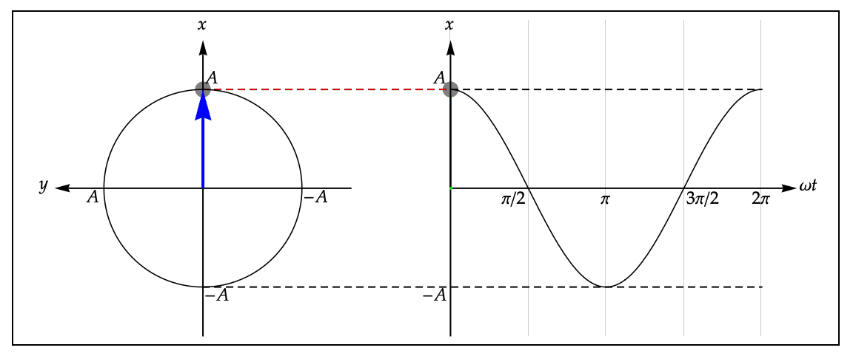

Slide 5
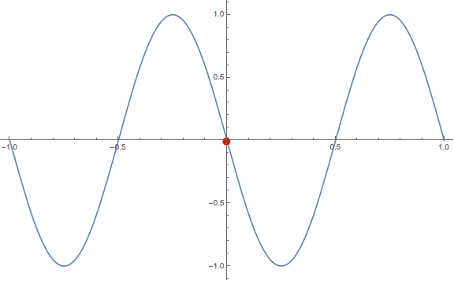

Slide 7
For more info:
takeuchi@vt.edu
http://www1.phys.vt.edu/~takeuchi/Tools/

